Slide 1
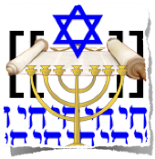


World Religions
Three of the world’s major religions originated in Southwest Asia:
Judaism
Christianity
Islam

Slide 2
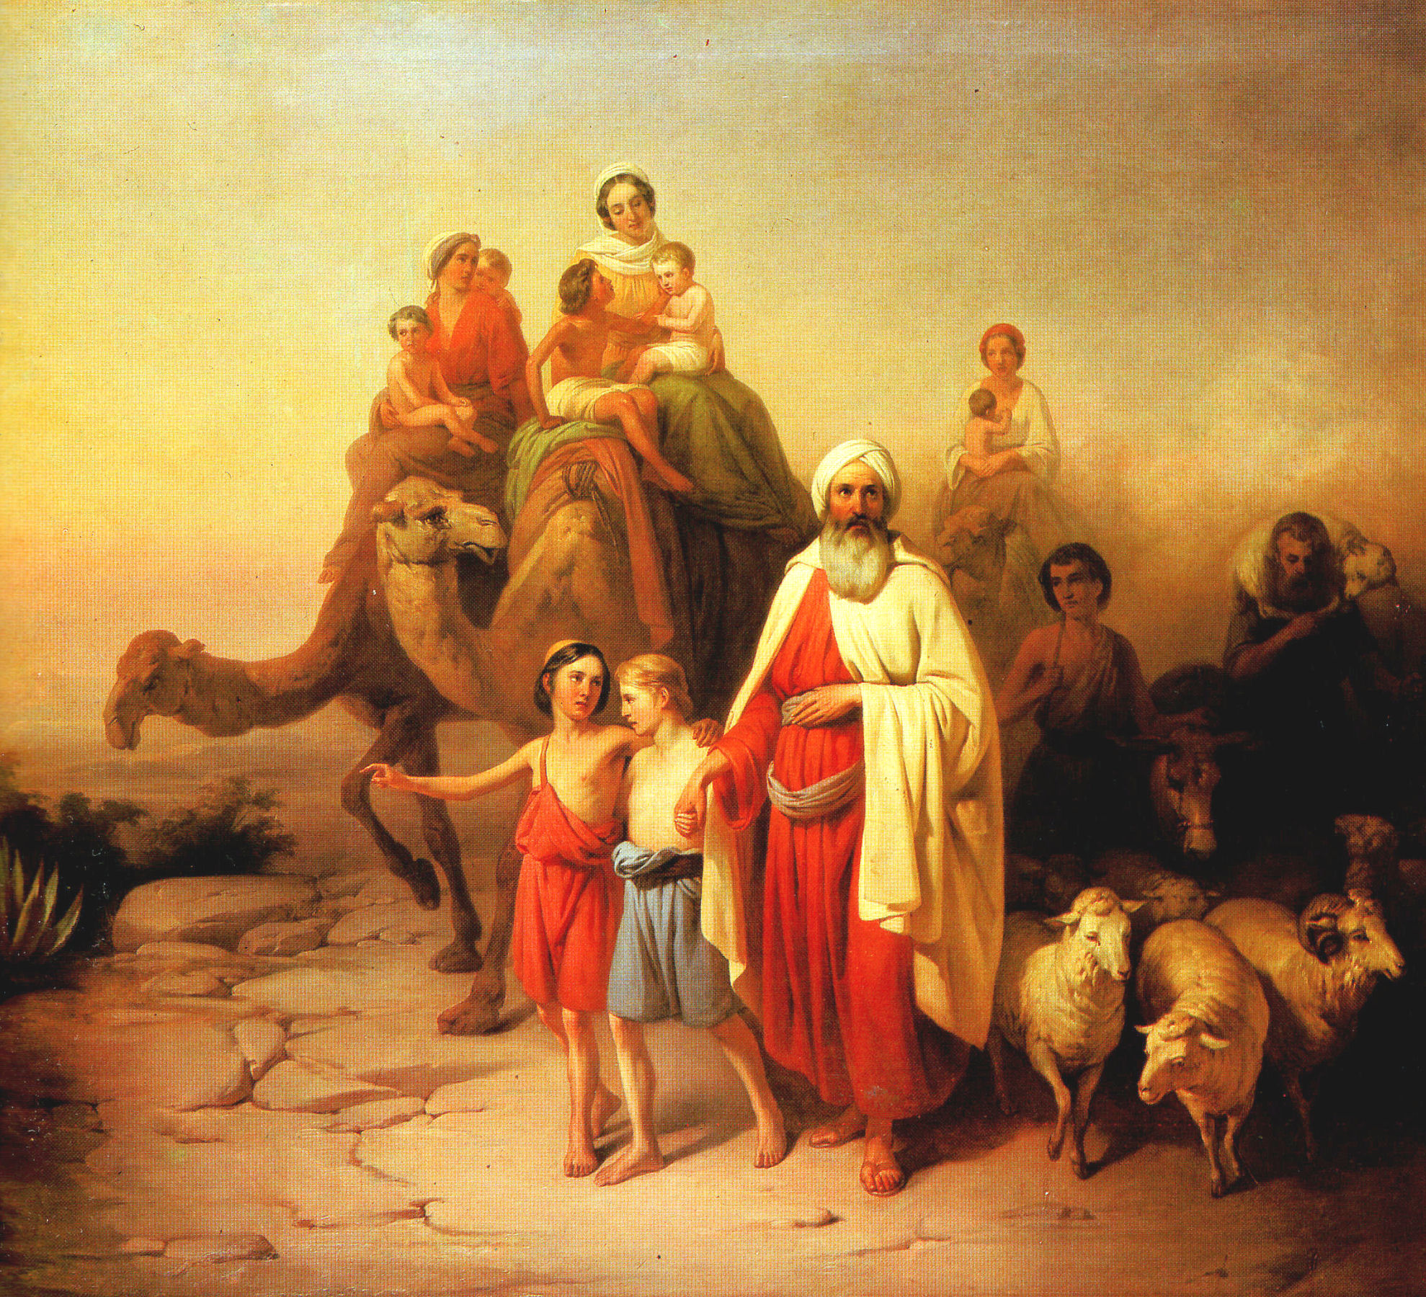
The Hebrews and Judaism
Chapter 7, Section 1

Slide 3
Key Terms
Judaism: the religion of the Hebrews
Abraham: the biblical father of the Hebrew people
Moses: Hebrew leader who led the Israelites from slavery in Egypt
Exodus: the journey the Israelites made from Egypt to Canaan, led by Moses
Ten Commandments: moral code of laws that God handed down to Moses
David: former outlaw who became king after the death of Saul, Israel’s first king
Solomon: David’s son; became king of the Israelites
Diaspora: the dispersal of the Jews outside of Canaan

Slide 4
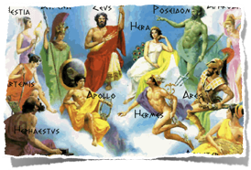
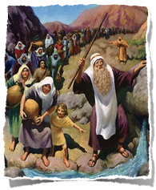
World Religions
In ancient times, most people worshiped many gods. This practice is known as polytheism.
A millennium is a period of one thousand years. During the second millennium B.C., a new religion arose.
This new religion was based on monotheism - the belief in just one God, and developed among a people called the Israelites. This religion came to be known as Judaism and its followers as Jews.

Slide 5
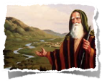
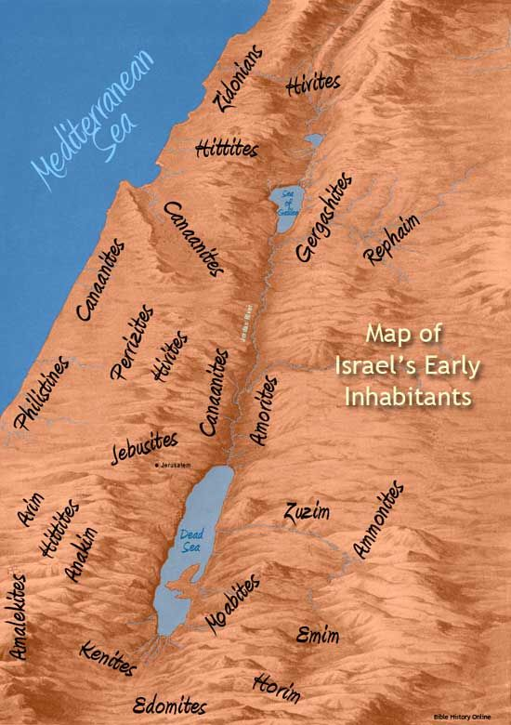
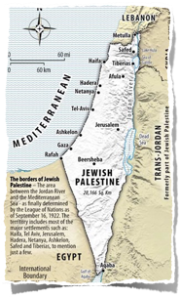
Judaism
Jews believe the father of the Israelite people was Abraham.
According to the Hebrew Bible, God called Abraham to leave his home in Mesopotamia and found a new nation in a land called Canaan, between the Jordan River and the Mediterranean Sea.
The area today is shared by Israel, the Palestinian territories, and Lebanon.

Slide 6
Abraham and Moses Lead their People
A people called the Hebrews (HEE-brooz) appeared in southwest Asia sometime between 2000 and 1500 B.C.
Their writings described the laws of their religion, Judaism (JOO-dee-i-zuhm).
The Hebrew Bible, or Torah, traces the Hebrews back to a man named Abraham.
The Hebrew Bible says that God told Abraham to leave his home.

Slide 7
Abraham and Moses Lead their People
Some of Abraham’s descendants, the Israelites, later moved to Egypt. In time, Egypt’s ruler, the pharaoh, made them slaves.
In the 1200s B.C., God then told a man named Moses to demand the Israelites’ freedom. The pharaoh agreed only after a series of plagues struck Egypt.
Moses led the Israelites out of Egypt in a journey called the Exodus. The Bible says that during this journey, God gave Moses two stone tablets with laws written on them known as the Ten Commandments.
The Israelites were to worship only God and to value human life, self-control, and justice. The Israelites reached Canaan after 40 years.

Slide 8
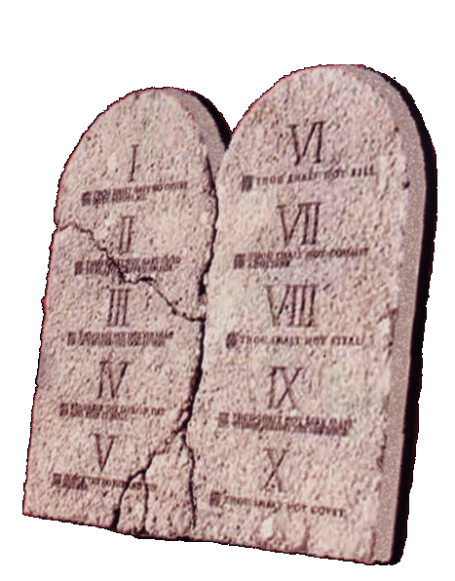
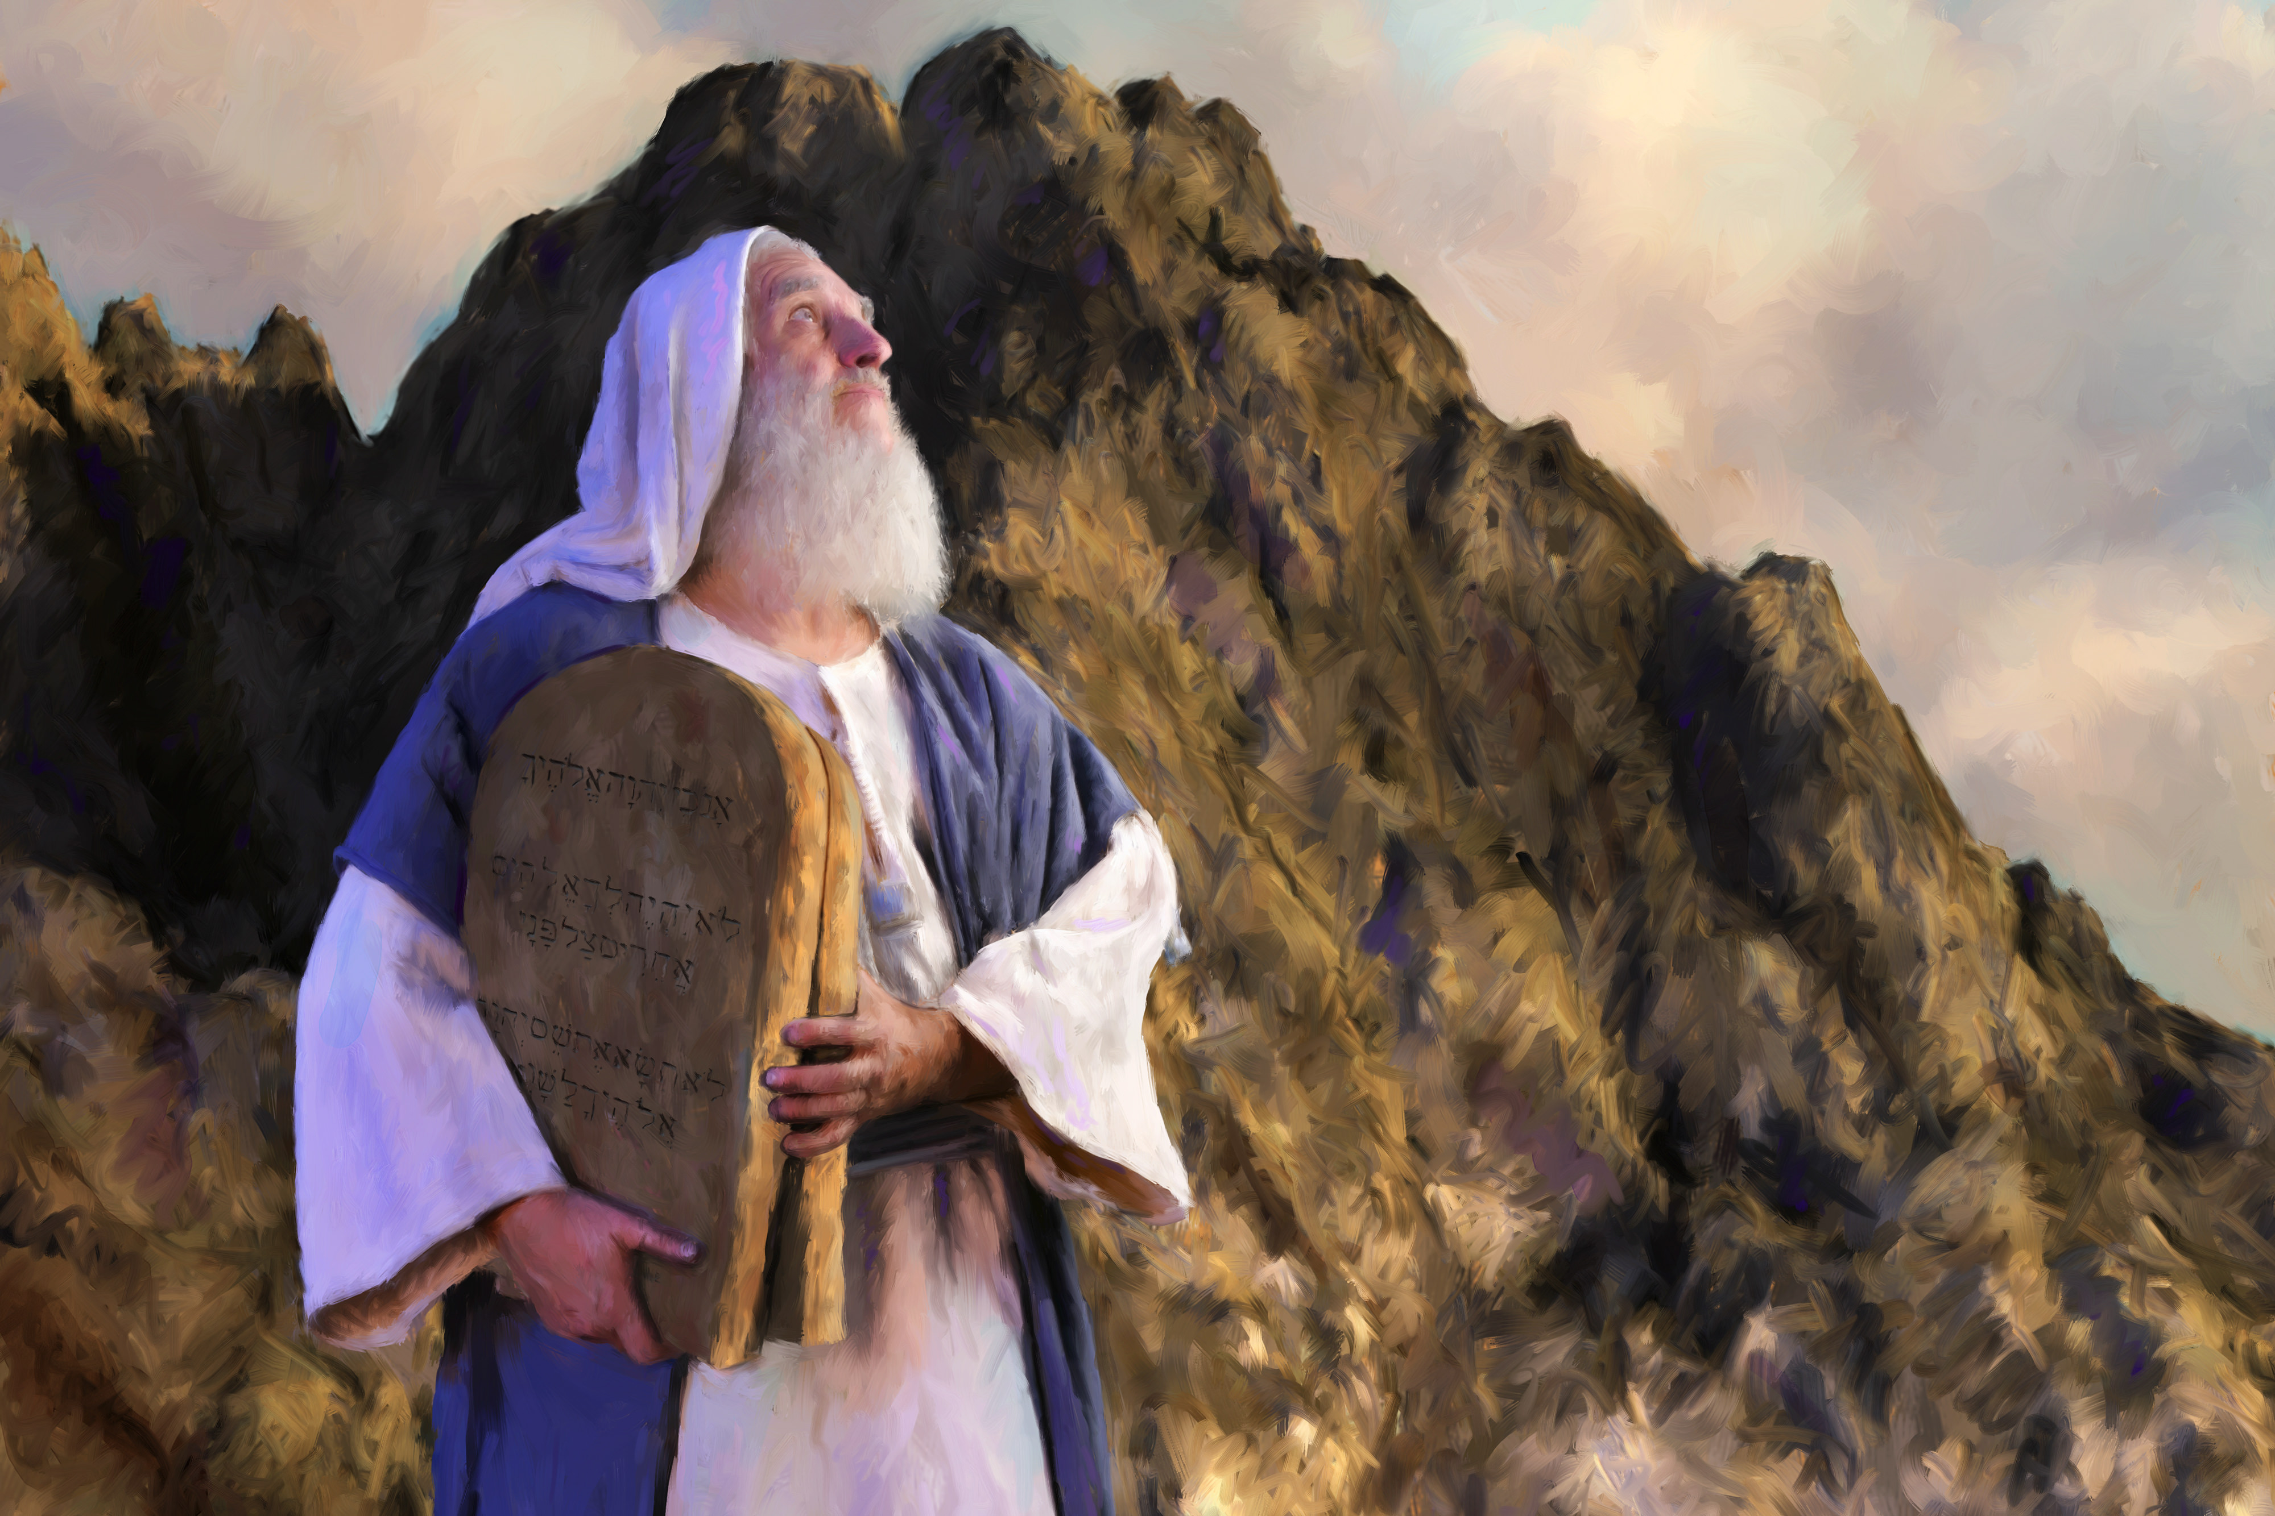
The Ten Commandments

Slide 9
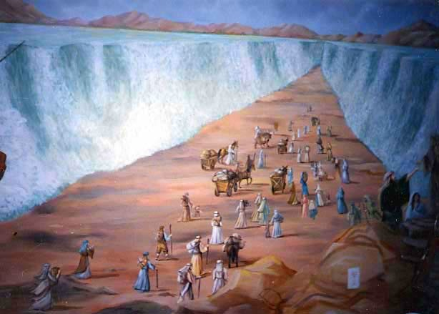
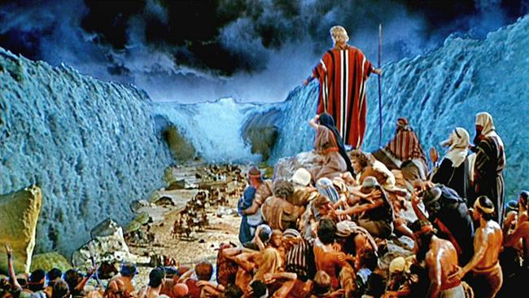
The Exodus

Slide 10
Kings Unite the Israelites
A man named Saul fought the Philistines and became the first king of Israel. After Saul died, a former outlaw named David became king.
David was well-loved. He defeated the Philistines and other enemies.
David captured the city of Jerusalem, which became Israel’s new capital. David’s son Solomon then became king around 965 B.C. Solomon was a strong king. He built a great temple in Jerusalem.

Slide 11
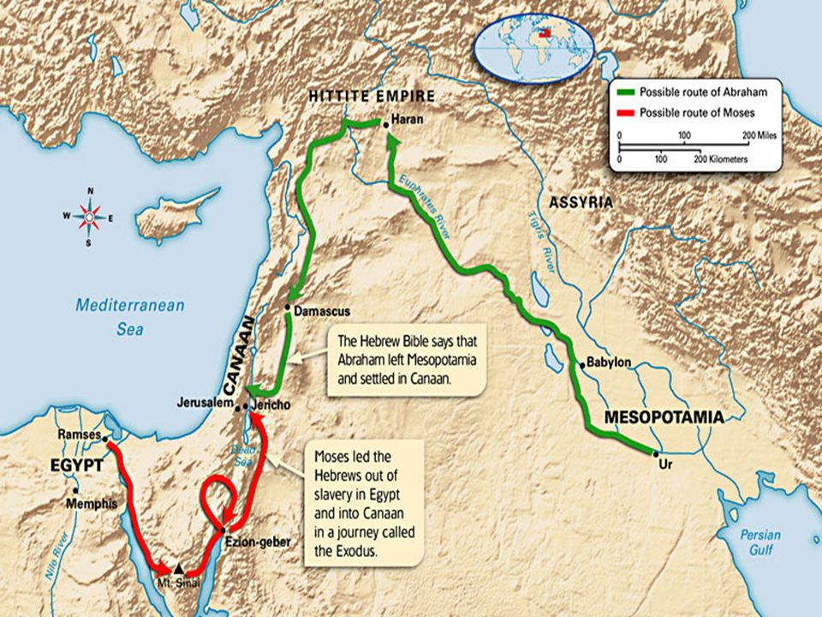
Possible Routes of Abraham and Moses

Slide 12
Invaders Conquer and Rule
After Solomon’s death in 930 B.C., revolts broke out over who should be king. Within a year, conflict tore Israel apart.
Israel broke into two kingdoms: Israel and Judah. The people of Judah became known as Jews.
The two new kingdoms lasted for a few centuries. In the end, both were conquered.
The Assyrians defeated Israel around 722 B.C.
Judah was defeated by the Chaldeans.

Slide 13
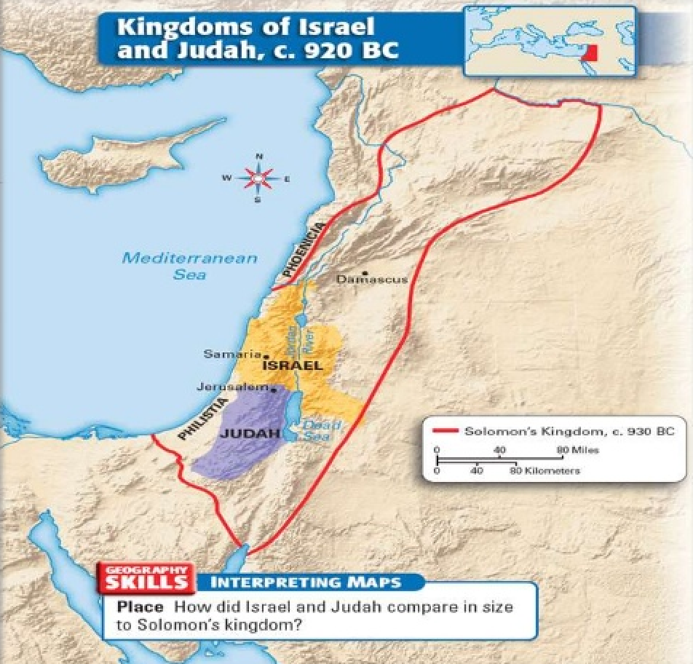

Slide 14
The Dispersal of the Jews
The Chaldeans captured Jerusalem and destroyed Solomon’s Temple in 586 B.C. The Jews were marched to Babylon to work as slaves (called the Babylonian Captivity).
In the 530s B.C., the Persians conquered the Chaldeans and let the Jews return to Jerusalem. Not all Jews returned to Jerusalem. Some moved to other parts of the Persian Empire.
Scholars call the dispersal of the Jews outside of Israel and Judah the Diaspora (dy-AS-pruh).
The Jews who returned to Jerusalem rebuilt Solomon’s Temple, which became known as the Second Temple.
The Jews remained under Persian control until the 330s BC, when the Persians were conquered by invaders.

Slide 15
Independence and Conquest
Tired of foreign rule, a Jewish family called the Maccabees led a successful revolt in the 160s B.C. and for about 100 years, the Jews again ruled their own kingdom.
In 63 B.C. the Jews were conquered, but this time by the Romans who made life difficult. Heavy taxes burdened the Jewish people.
The Romans had no respect for the Jewish religion and way of life. Some rulers tried to force the Jews to worship the Roman Emperor. The Roman rulers appointed the high priests, the leaders of the Temple, which was more than the Jews could bear.
The Jews called on their people to rebel against the Romans.

Slide 16
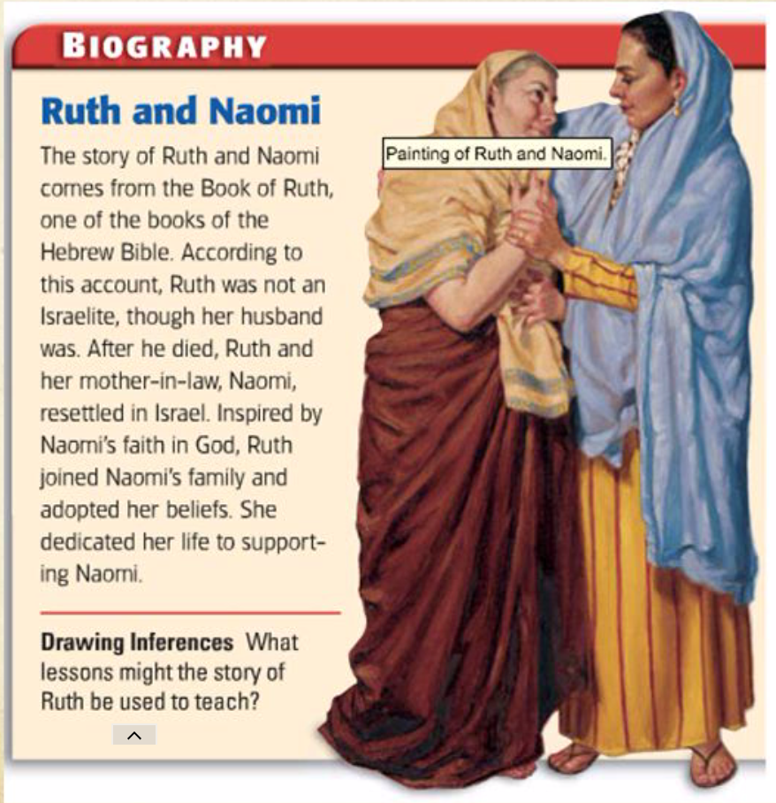
Women in Israelite Society
Men dominated Israelite society, but some Israelite and Jewish women made great contributions to their society as described in the Hebrew Bible.
Some women were political and military leaders such as Queen Esther and the judge Deborah.
Other women, such as Miriam, the sister of Moses, were spiritual leaders.
Ruth, who left her people to care for her mother-in-law, was seen as a model of devotion to one’s family.

Slide 17
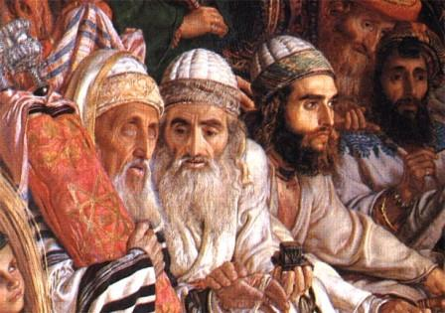
The Hebrews and Judaism
Section 2

Slide 18
Key Terms
monotheism: belief in only one god
Torah: the sacred text of Judaism
synagogue: Jewish house of worship
prophets: people said to receive messages from God to be taught to others
Talmud: commentaries, stories, and folklore recorded to explain Jewish laws
Dead Sea Scrolls: writings by Jews who lived about 2,000 years ago

Slide 19
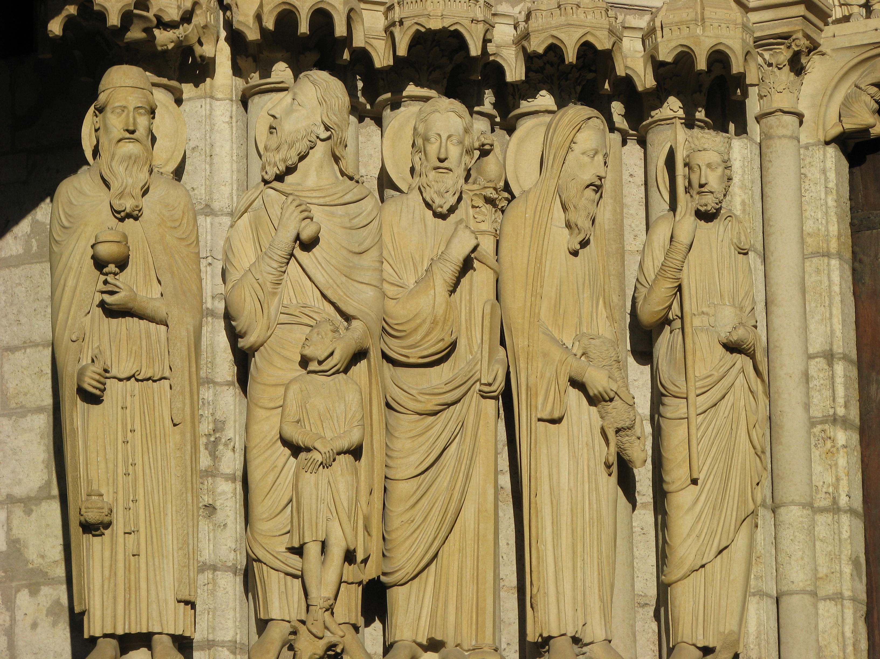
Jewish Beliefs Anchor their Society
Jewish society is founded upon religion. Judaism’s main beliefs are beliefs in God, education, justice, and obedience.
Judaism is the oldest known religion to practice monotheism. The Hebrew name for God is YHWH (Yahweh).
The Jews say their history was guided through God’s relationship with Abraham, Moses, and other leaders.

Slide 20
Jewish Beliefs Anchor their Society
Moral and religious laws, believed to be handed down from God, have guided Jewish society through their history and continue to do so today.
Besides the Ten Commandments, Jews believe that Moses recorded a whole set of laws governing Jewish behavior. These laws are called Mosaic law. These laws set down rules for everything including what to eat, when to work, and how to pray.
Today, Orthodox Jews continue to follow all of the Mosaic laws. Reform Jews choose not to follow many of the ancient rules. Conservative Jews fall in between.

Slide 21
Texts List Jewish Beliefs
The laws and principles of Judaism are written down in sacred texts. The most important text is the Torah.
The five books of the Torah record most of the laws and the history of Judaism until the death of Moses.
Every synagogue, or place of Jewish worship, has at least one Torah.
The Torah is one of the three parts of the Hebrew Bible, or Tanakh. The second part contains messages from prophets. The third part is a collection of poems, songs, stories, lessons, and histories.
The Talmud is a collection of commentaries, folktales, and stories written by scholars. These are intended to help people understand and analyze the laws described in the Hebrew Bible.

Slide 22
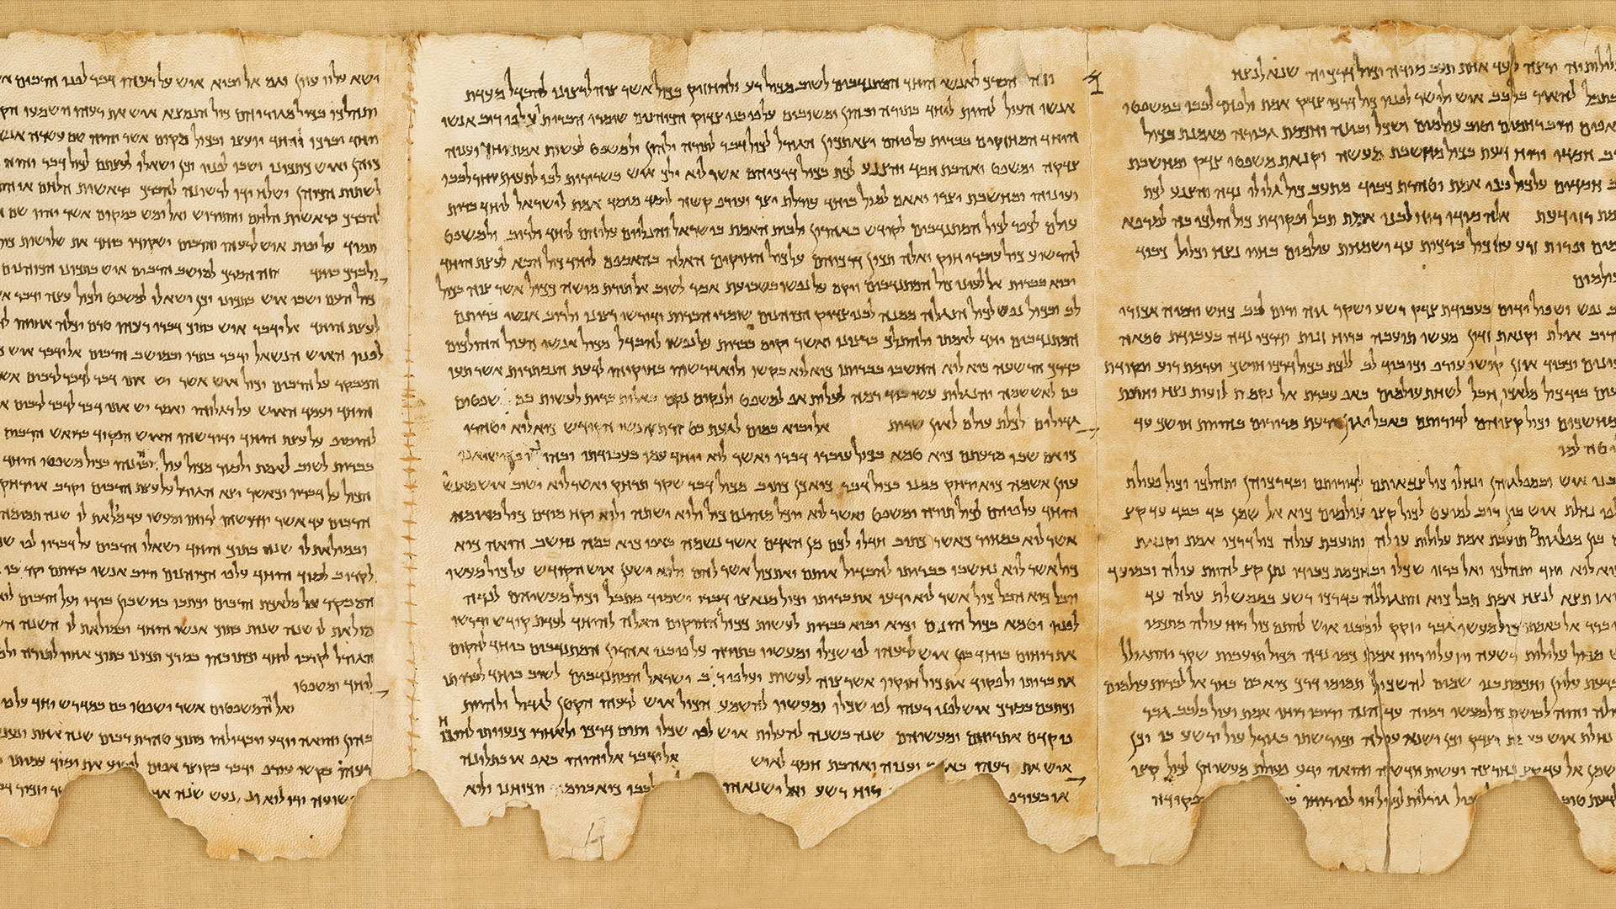
Scrolls Reveal Past Beliefs
Another set of ancient texts, the Dead Sea Scrolls, were discovered in 1947. These scrolls, written by Jewish scholars about 2,000 years ago, contain commentaries and stories, and offer more information about ancient Jewish life.

Slide 23
Judaism and Later Cultures
Jewish ideas have helped shape two other major world religions, Christianity and Islam. The Ten Commandments are reflected in the laws of Christianity and in modern society’s rules of behavior.

Slide 24
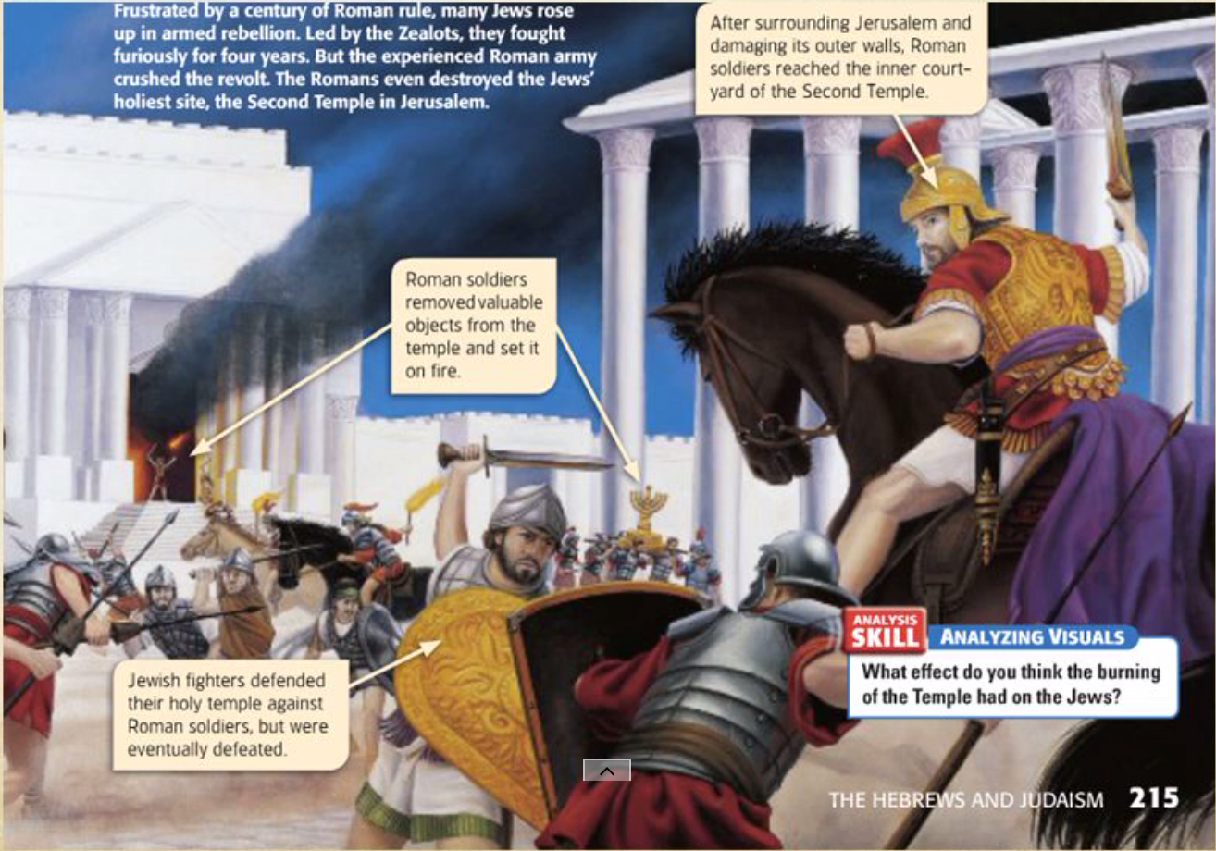
Judaism Over the Centuries
Section 3

Slide 25
Key Terms
Zealots: Jews who rebelled against their Roman rulers
Rabbis: teachers who guide Jews in their religious lives
Passover: a time for Jews to remember the Exodus
High Holy Days: the two most sacred Jewish holidays, Rosh Hashanah and Yom Kippur

Slide 26
Revolt, Defeat, and Migration
The teachings of Judaism helped unite the ancient Jews. But many Jews were unhappy with the Roman rule of Jerusalem. Tensions increased. Some Jews refused to obey Roman officials.
In AD 66, a group called the Zealots led a rebellion against Rome. After four years of fierce fighting, the rebellion failed.
The Jews’ main temple was destroyed in AD 70. The Romans put down another Jewish rebellion 60 years later.
After this uprising, Jews were banned from living in Jerusalem. They then migrated to other parts of the world.

Slide 27
Two Cultural Traditions
Because Jews could no longer worship at a central temple, their traditions changed. Everywhere Jews went, they built local temples.
Jews appointed rabbis.
Even with a similar culture and background, Jewish traditions grew differently depending on where they moved.

Slide 28
Two Major Jewish Cultures
The Ashkenazim are descended from Jews who moved to France, Germany, and Eastern Europe during the Diaspora. These Jews maintained separate customs from the region’s residents. They even developed their own language, called Yiddish.
The Sephardim are descended from Jews who moved to Spain and Portugal during the Diaspora. They have their own language: Ladino (a mix of Spanish, Hebrew, and Arabic).
Unlike the Ashkenazim, the Sephardim mixed with their non-Jewish neighbors. As a result, Sephardic religious and cultural practices were borrowed.
During the Golden Age of Jewish culture (AD 1000s to 1100s), Jewish poets wrote beautiful works and Jewish scholars made great advances in mathematics, astronomy, medicine, and philosophy.

Slide 29
Traditions and Holy Days
Jewish culture is one of the oldest in the world.
Jews feel a very strong connection with the past.
Jewish traditions and holy days help them understand and celebrate their history.

Slide 30
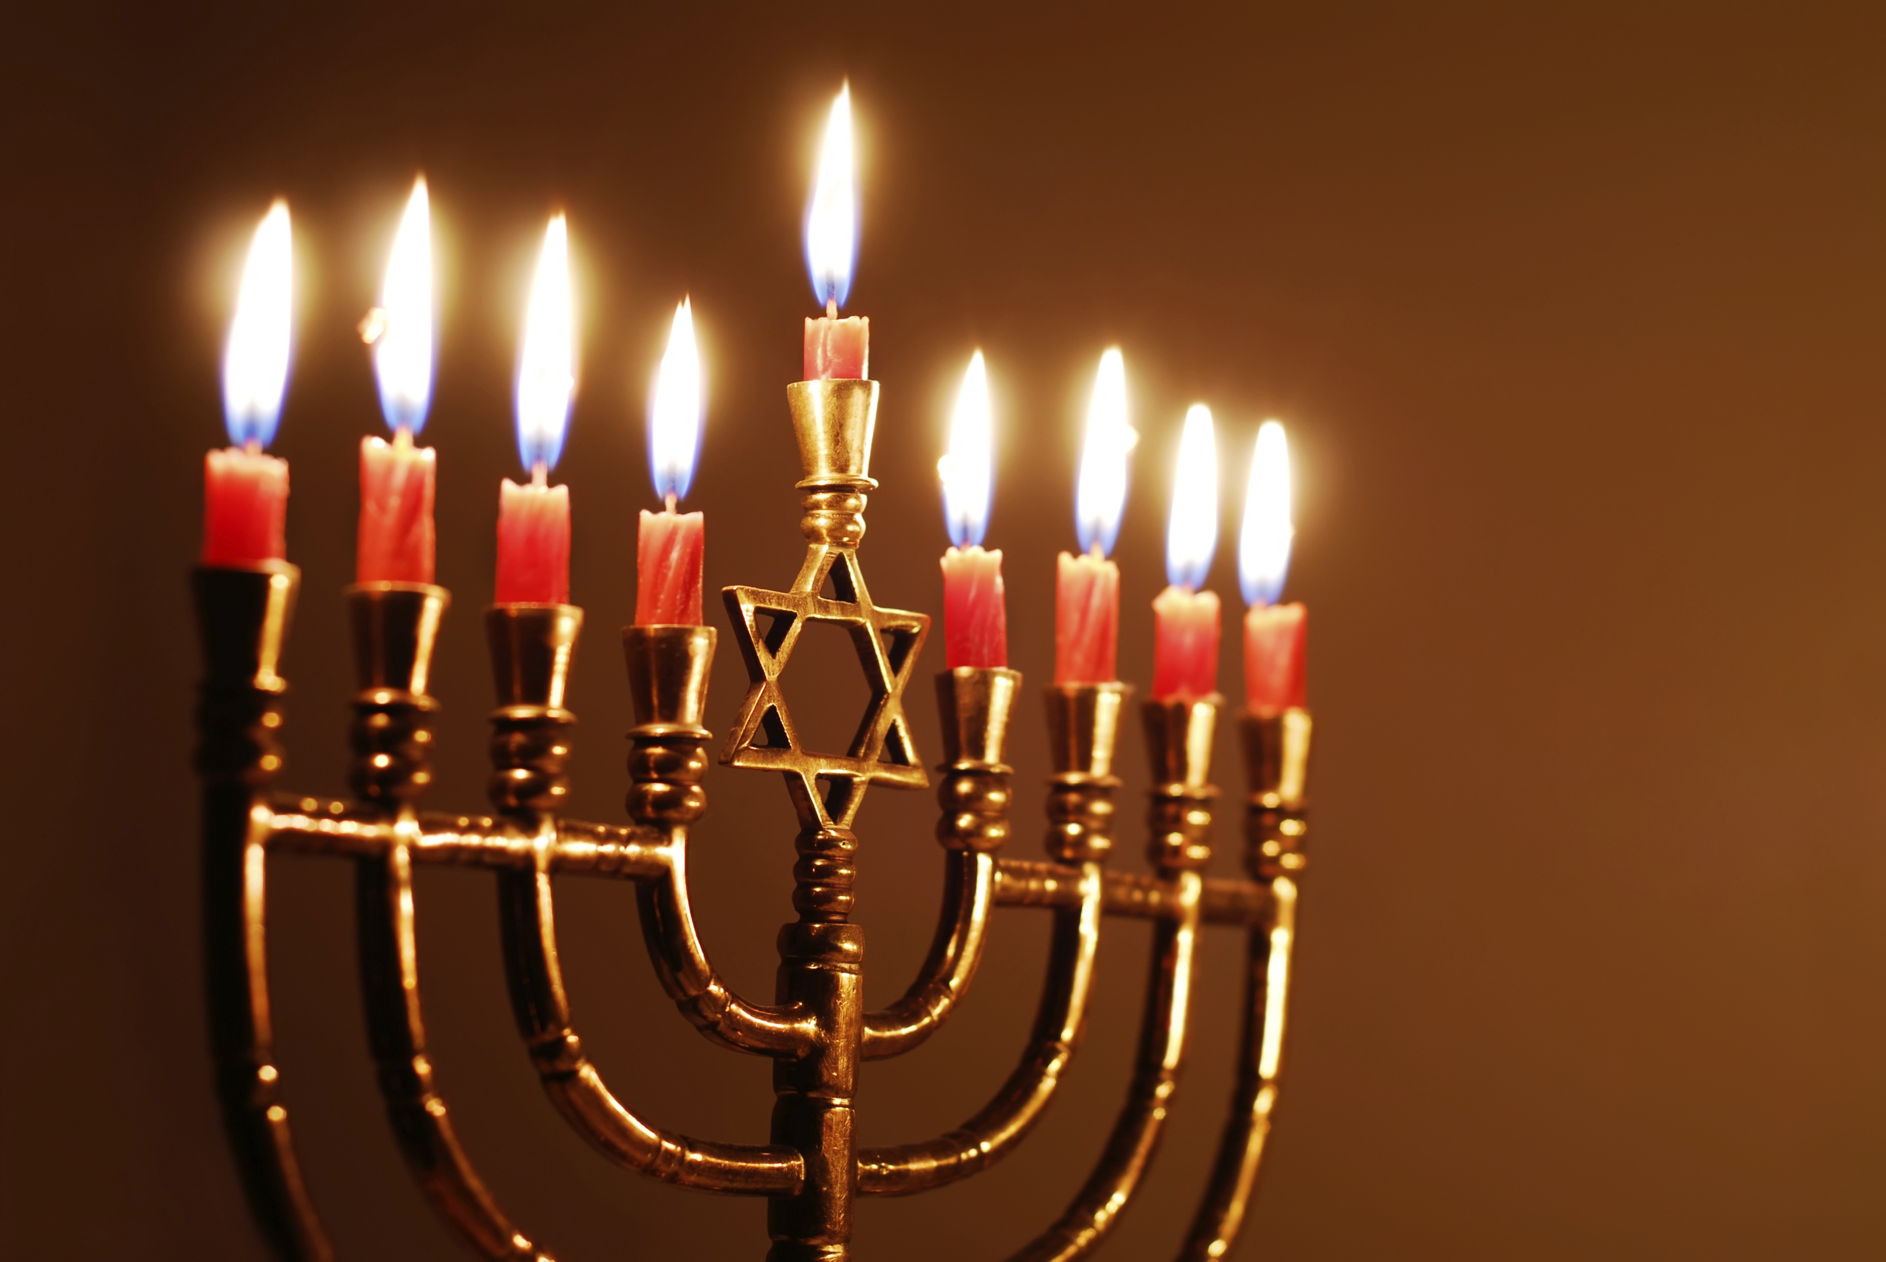
Hanukkah
Celebrated in December and honors the rededication of the Second Temple during the revolt of the Maccabees.
The Maccabees wanted to celebrate that their non-Jewish rulers let them keep their religion, but the Maccabees didn’t have enough lamp oil to perform the rededication ceremony.
Miraculously, the oil they had – enough to burn for only one day – burned for eight full days.
Today, Jews celebrate this event by lighting a special candle holder called a menorah with eight branches that represent the eight days the oil burned.

Slide 31
Passover
Celebrated in March or April and is a time for Jews to remember the Exodus (the journey of the Israelites out of slavery in Egypt).
According to Jewish tradition, the Israelites left Egypt so quickly that bakers didn’t have enough time to let the bread rise.
During Passover, Jews eat only matzo, a flat, unrisen bread.
Jews also eat a special meal called a seder (SAY-duhr), when they recall and reflect upon the events of the Exodus.

Slide 32
High Holy Days
The two most sacred days of all Jewish holy days take place each year in September or October.
The first two days of the celebration, Rosh Hashanah, celebrate the beginning of a new year in the Jewish calendar.
Yom Kippur falls soon afterward and is when Jews ask God to forgive their sins. Jews consider Yom Kippur to be the holiest day of the entire year and don’t eat or drink anything for the entire day.
These ceremonies help many Jews feel more connected to their long past, to the days of Abraham and Moses.

Slide 33
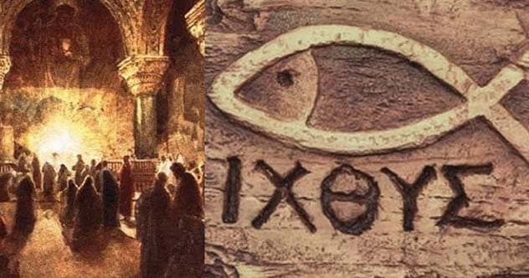
Christianity

Slide 34
Christianity
The Big Idea: People in the Roman Empire practiced many religions before Christianity, based on the teachings of Jesus of Nazareth, spread and became Rome’s official religion.
Main Ideas:
  Despite its general religious tolerance, Rome came into conflict with the Jews.
  A new religion, Christianity, grew out of Judaism.
  Many considered Jesus of Nazareth to be the Messiah.
  Christianity grew in popularity and eventually became the official religion of Rome.

Slide 35
Main Idea #1: Despite its general religious tolerance, Rome came into conflict with the Jews.
Romans were accepting of the gods of the people that they conquered, and they prayed to a wide range of gods.
  They were not sure which gods existed and which did not, so to avoid offending the ones that did exist, they prayed to a wide range of gods and goddesses.
The Romans would ban a religion if it was considered to be a threat or political problem.

Slide 36
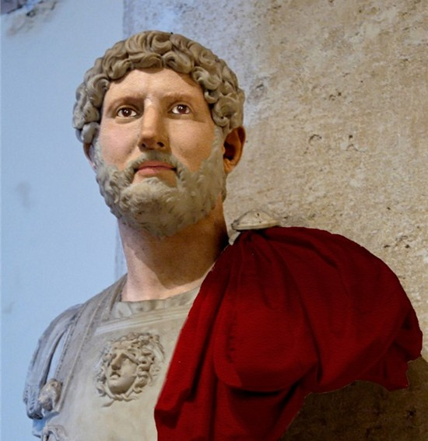
Jews and Romans Clashed
Religious Reasons
The Romans worshipped many gods, whereas the Jews worshipped only one God.
Some Romans thought the Jews were insulting their gods by worshipping only one God.
Political Reasons
The Jews rebelled against Roman rule twice and were defeated.
Emperor Hadrian banned the practice of some rituals in the hope of ending the desire for independence.
The Jews rebelled again and the Romans crushed the revolt and destroyed Jerusalem in 135, forcing the remaining Jews to leave the city.

Slide 37
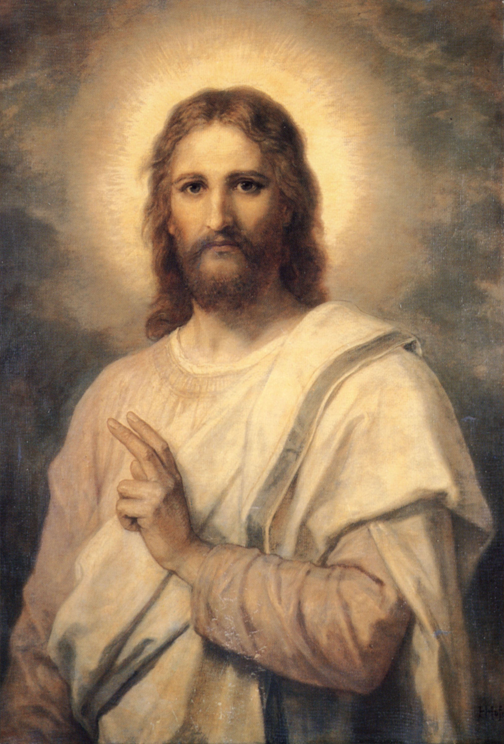
Main Idea #2: A New Religion, Christianity, Grew out of Judaism.
Before the Jews rebelled, a new religion appeared in Judea.
This religion was based on the teachings of Jesus of Nazareth.
It was rooted in Jewish ideas and traditions.

Slide 38
The Messiah
Messiah means “anointed” in Hebrew.
The Jews believed that the Messiah would be chosen by God to lead hem.
The Jews believed that if they followed the laws closely, a descendant of King David would come to restore the kingdom.
A prophet named John the Baptist announced that this leader, the Messiah, was coming soon.

Slide 39
Main Idea #3: Many Considered Jesus of Nazareth to be the Messiah
The limited knowledge about Jesus’s life is contained in the Bible, the holy book of Christianity.
The Bible is made up of two parts:
  The Old Testament tells the history and ideas of the Hebrew people.
  The New Testament tells about the life and teachings of Jesus.

Slide 40
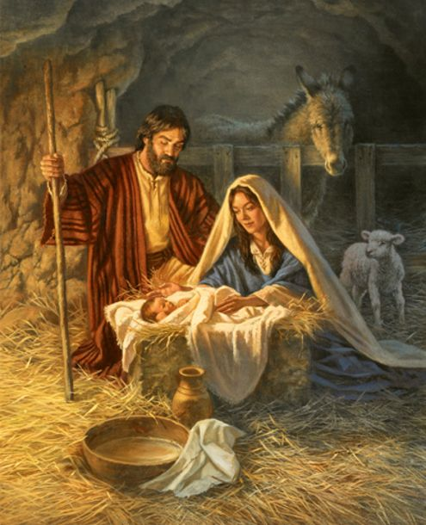
The Birth of Jesus
According to the Bible, Jesus was born in Bethlehem to Mary and Joseph.
Jesus probably studied carpentry and Judaism.
Stories of his teachings and actions make up the beginning of the New Testament.

Slide 41
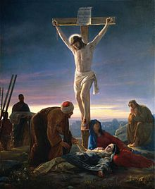
The Crucifixion and Resurrection
Jesus’s teachings challenged the authority of political and religious leaders who arrested him.
He was tried and put to death by crucifixion, a type of execution in which a person is nailed to a cross.
According to Christian belief, Jesus rose from the dead on the third day after his death, which is referred to as the Resurrection.

Slide 42
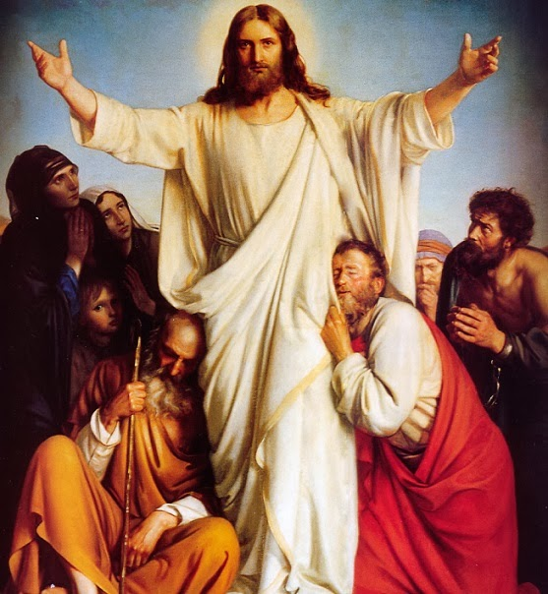
The Crucifixion and Resurrection
After the Resurrection, several groups of Jesus’s disciples, or followers, claimed to see him again.
Some people called him Jesus Christ, which is how the words Christians and Christianity eventually developed.
  Christ comes from Christos, the Greek word for Messiah.

Slide 43
The Teachings of Jesus
Much of Jesus’s message was rooted in older Jewish traditions:
  Love God
  Love other people
Jesus taught that people who were saved from sin would enter the kingdom of God when they died. He told people how to live in order to reach the kingdom of Heaven.
Over the centuries since Jesus lived, people have interpreted his teachings differently, creating denominations of Christians.
  Lutheran, Anglican, Evangelical, Methodist, Presbyterian, Pentecostal, Eastern Orthodox, Baptist, etc.)

Slide 44
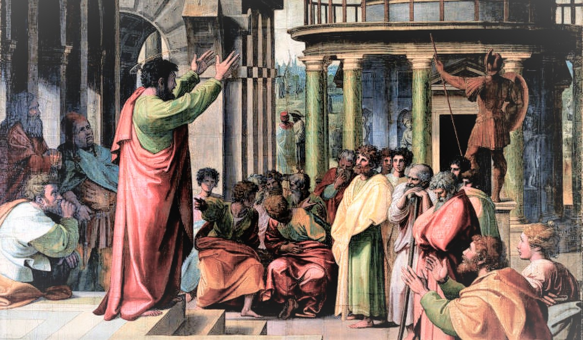
The Spread of Jesus’s Teachings
Jesus chose people to pass along his teachings.
  12 Apostles
    They were Jesus’s closest followers during his lifetime.
    Peter became leader of the group after Jesus died.
  The writers of the Gospels were Matthew, Mark, Luke, and John.
Saint Paul was also known as Paul of Tarsus. He became one of the most important figures in the spread of Christianity. In his letters, he wrote about the Resurrection and about salvation. He also told Christians that they didn’t have to obey all Jewish laws and rituals, which helped the Christian church break away from Judaism.

Slide 45
Main Idea #4: Christianity Grew in Popularity and Eventually Became the Official Religion of Rome
The first Christians spread Jesus’s teachings only among Jews, but Paul and other Christians introduced Christianity to non-Jews (Gentiles) as well.
Christianity began to spread rapidly and within one hundred years after Jesus’s death, thousands of Christians lived in the Roman Empire.
Christians trying to spread their beliefs were met with challenges. Many Christians who refused to worship Rome’s gods were arrested and killed for their religious beliefs.
A few Roman emperors feared that Christians would cause unrest, so they banned Christianity.

Slide 46
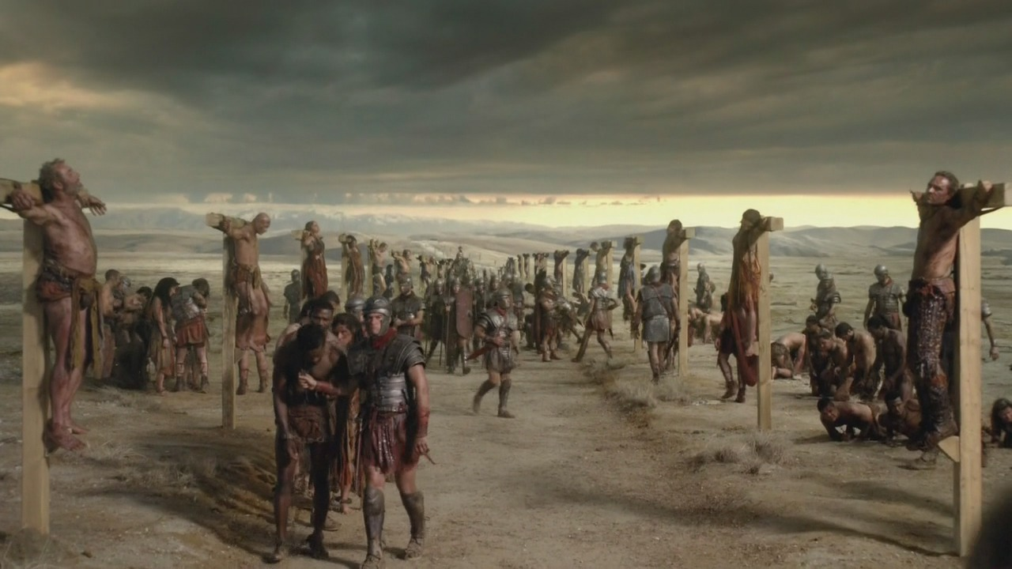
Persecution
Banning Christianity began a period of persecution against Christians.
Persecution is the punishment of a group because of religious beliefs.
Appian Way

Slide 47
Spread of Christianity
Christians began to meet in secret, but continued to spread their faith.
In the early 300s, the emperor Constantine experienced a powerful conversion and became a Christian.
Constantine removed the bans on Christianity.
A later emperor made Christianity Rome’s official religion.

Slide 48
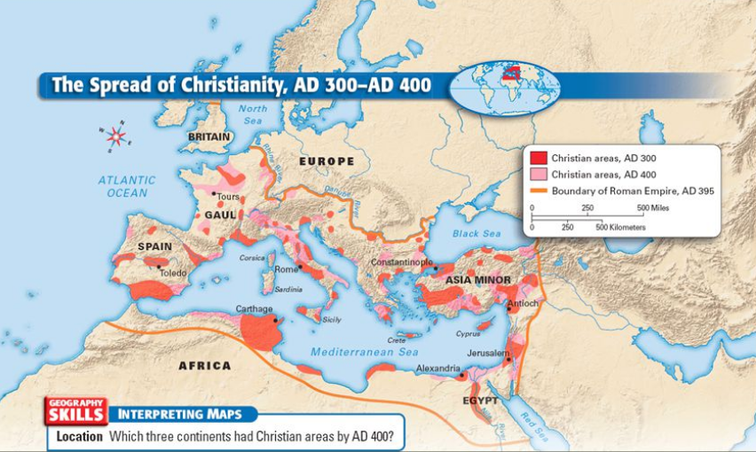
Spread of Christianity

Slide 49
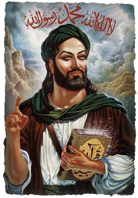
Islam
In the A.D. 600s, Islam - the religion of Muslims - arose in the Arabian Peninsula.
Muhammad, regarded by Muslims as the last and greatest of the prophets, announced his message in the desert city of Makkah (Mecca).
Many of the teachings if Islam are similar to those of Judaism and Christianity.
All three religions are monotheistic and believe Abraham is the messenger of God who first taught this belief.

Slide 50
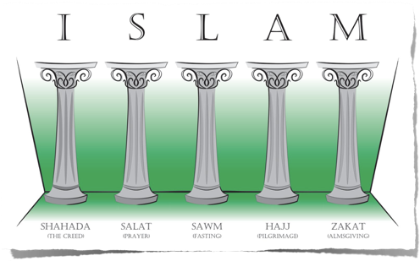
Islam
The Islamic religion was relatively simple. It focused on the need to obey the will of Allah, the Arab word for God.
Followers were obligated to perform five duties, or what is known as the Five Pillars of Islam.

Slide 51
Five Pillars of Islam
Promising faith to God and accepting Muhammad as God’s prophet.
Praying five times daily.
Fasting during the month of Ramadan (Rahm-uh-don). Ramadan begins on June 5, 2016, at sundown.
Aiding the poor and unfortunate.
Making a pilgrimage to the holy city of Makkah (Mecca).

Slide 52
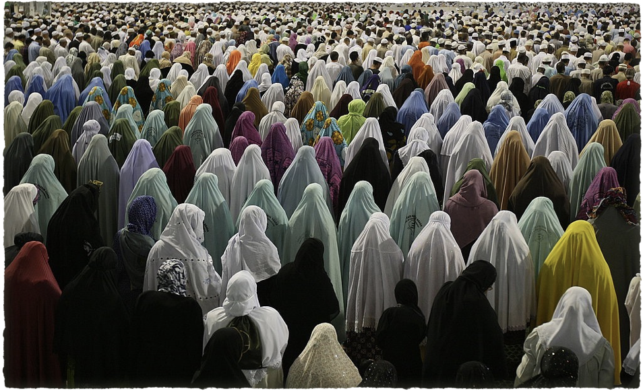

Slide 53
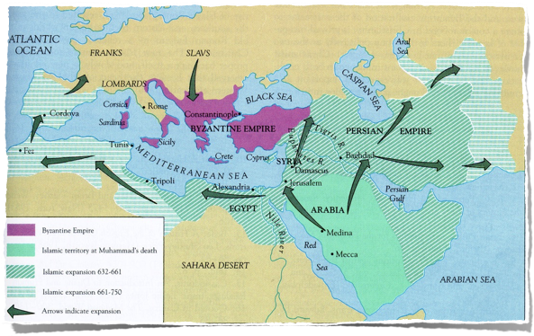
Islamic Expansion
In the beginning, Islam attracted few converts, but by the time of Muhammad’s death in A.D. 632, it had expanded across the Arabian Peninsula.

Slide 54
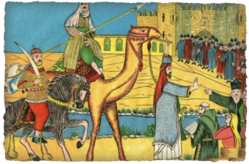
Islamic Expansion
Caliphs (Kay-lifs) were Muhammad’s successors (leaders that came after him).
They formed Arab armies who began spreading the religion through military conquests.
Islam was also spread by scholars, by religious pilgrims, and by Arab traders.

Slide 55
Islamic Expansion Timeline
The Ottoman Empire (from Anatolian Peninsula) grows to include parts of Southwest Asia, southeastern Europe, and northern Africa.
Islam spreads across SW Asia, part of Turkey, most of Spain and Portugal, and across North Africa.
Crusaders from Western Europe set up Christian states along Southwest Asia’s Mediterranean coast.
Muslims regained territories, but military power weakened in other areas.
Islam expands into eastern Africa, Central, South, and Southeast Asia.
Muhammad’s Death
A.D. 632
A.D. 800
A.D. 900+
A.D. 1100s and 1200s
A.D. 1300
A.D. 1350
A.D. 1900
The Mongols, lead by grandson of Genghis Khan, conquered Persia and Mesopotamia, becoming part of an empire that stretched across much of Eurasia.
At the height of the Ottoman Empire, it was one of the world’s most powerful states. It endured for six centuries before finally collapsing in the early 1900s.

Slide 56
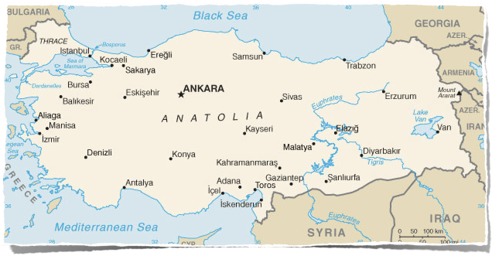
Modern Southwest Asia
After the collapse of the Ottoman Empire and the end of WWI, the modern country of Turkey was founded on the Anatolian Peninsula.

Slide 57
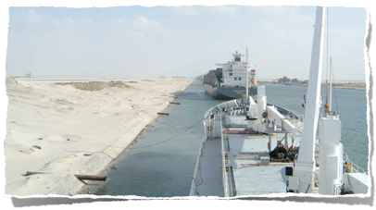
  European Interest
Construction of the Suez Canal was completed in 1869, making it an important world waterway.
In a peace settlement that ended WWI, Britain and France gained control over the Ottoman Empire’s former territories under a mandate system - people of these territories were to prepare for independence.

Slide 58
Dividing Up Territories
The British and French created new political boundaries that did not consider existing ethnic, religious, political, or historical divisions.
These boundaries would become even more important when the countries became independent and when new discoveries of petroleum deposits were made.
Strong resentment toward the European colonial powers grew into movements among Arabs, Persians, Turks, and other groups.
Between 1930 and 1971, one country after another gained its independence.

Slide 59
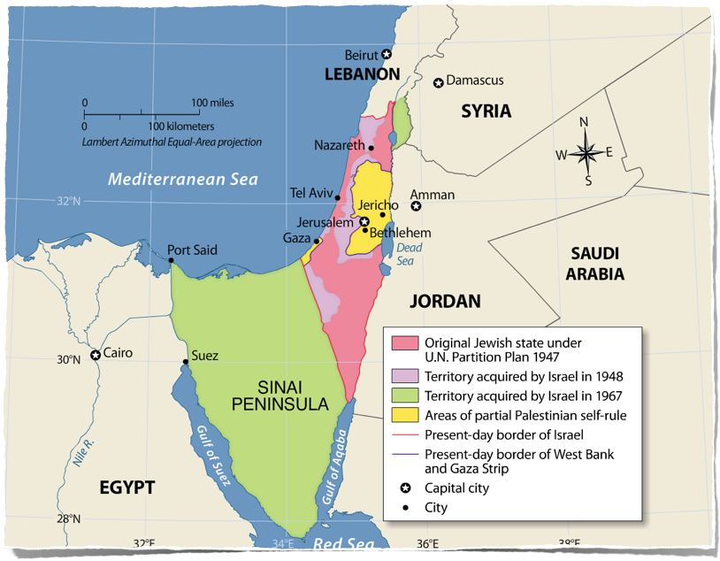

Slide 60
Arab-Israeli Conflict
In ancient times, the land of Israel was inhabited by the Jewish people.
After WWI, this territory was called Palestine. Most of the people living in Palestine at the time of the mandate were Muslim Arabs.
During this same period, growing numbers of Jewish immigrants seeking to escape persecution in Europe and other parts of the world began arriving into Palestine.
As the Jewish population increased, tensions between Palestinian Arabs and Jews deepened.
We will look closer at this issue through our study of “Promises.”

Slide 61
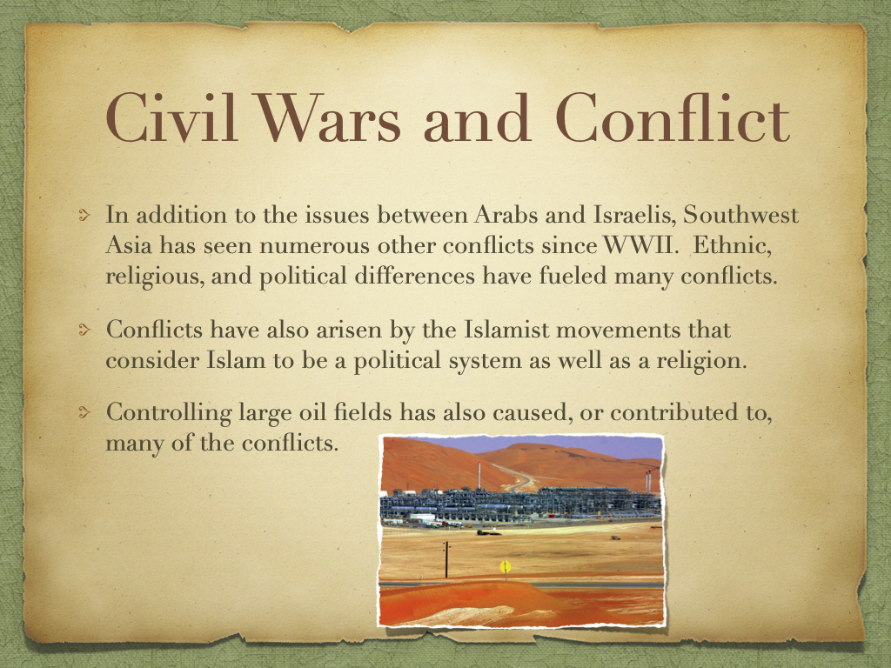

Slide 63
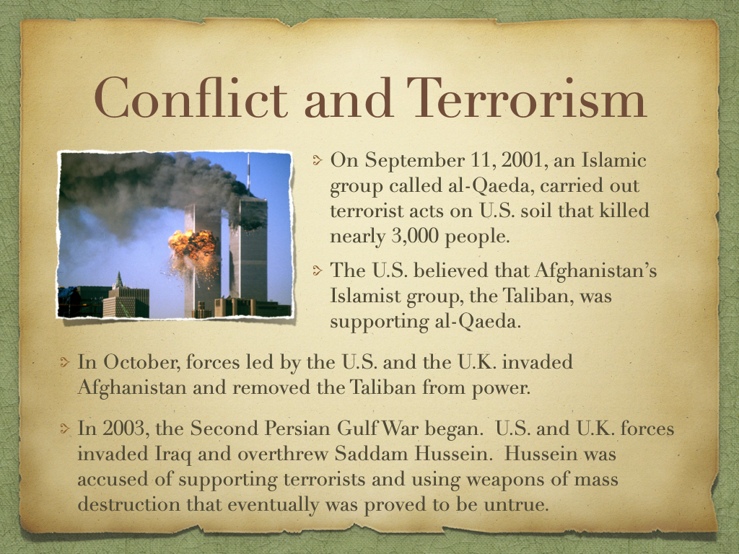

Slide 64
