Slide 1
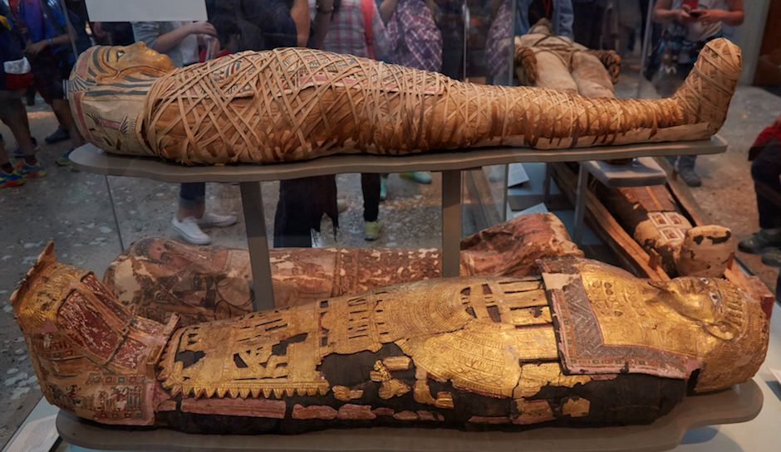
Egyptian
Mummification

Slide 2
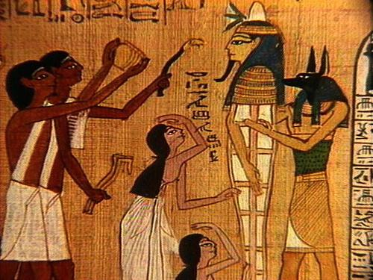
Purpose of Egyptian Mummification
The ancient Egyptians believed that after death their bodies would travel to another world during the day, and at night they would return to their bodies.

Slide 3
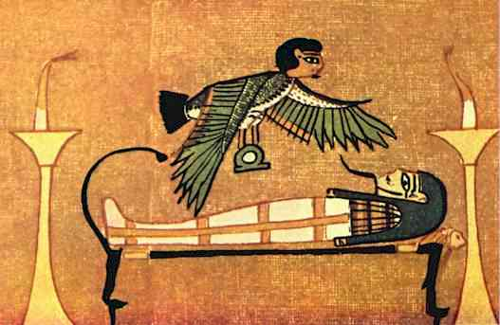
In order for the person’s Ka (or spirit) to live forever, it had to be able to recognize and return to the body. If a Ka could not recognize the body it belonged to, it would die.
This is why the Egyptians wanted to preserve the bodies of the dead in as lifelike a way as possible. Mummification guaranteed eternal life for the spirit.

Slide 4
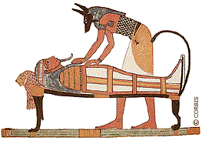
The Mummification Process
The entire process took 70 days to complete. Several embalmers conducted the task in the special embalming shop or per nefer. The chief embalmer was known as the hery sheshta. He wore a jackal mask to represent Anubis, the god of mummification.

Slide 5
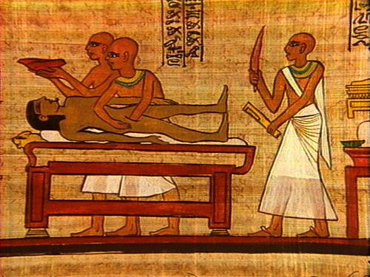
After the body had been shaved and washed with wine and spices, all of the soft body parts that might decay were removed.
The embalmers first removed the brain through the nose using a long hook. Next they would remove the internal organs (the lungs, the stomach, the liver, and the intestines) through a deep incision that was made in the left side of the abdomen. In some cases they removed the heart, but in others, they left it.

Slide 6
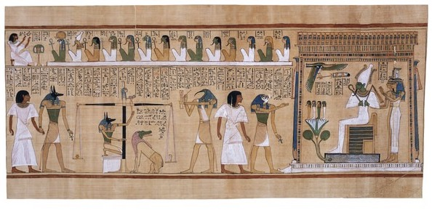
The Papyrus of Ani
The Ceremony of Weighing the Heart and Feather
(Click image to view video or go go:
http://quietube7.com/v.php/http:/www.youtube.com/watch?v=1yv_MXNYbAo)

Slide 7
Back to the Mummification Process…
The body was then stuffed with bundles of strong drying salt called natron.

Slide 8
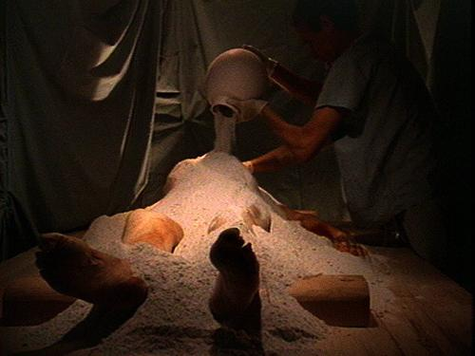
The body was then completely covered with natron and placed on a slanted couch so that any fluids that dripped out, as the body was drying, could be collected and buried along with it.

Slide 9
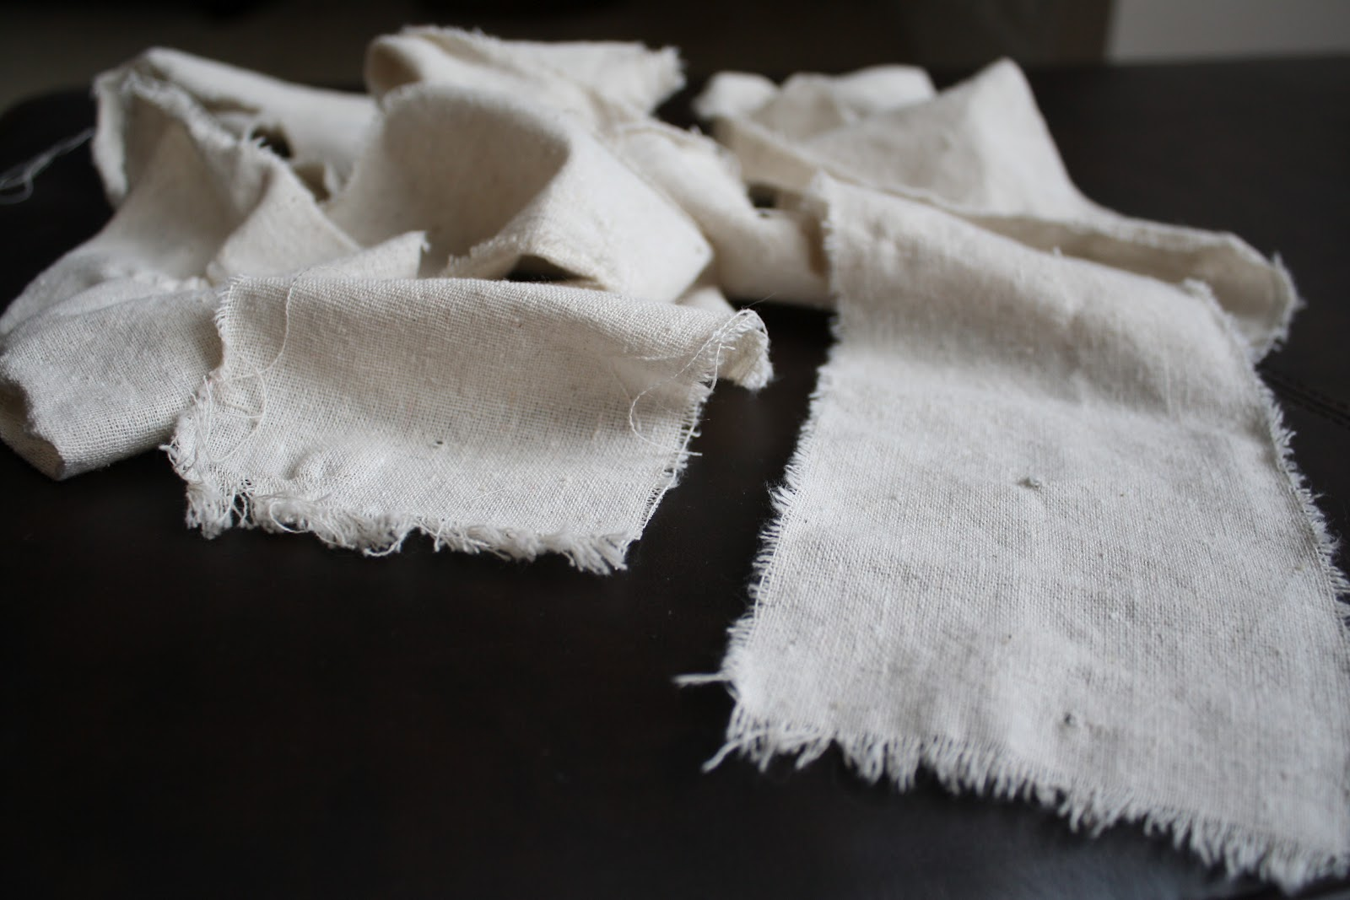
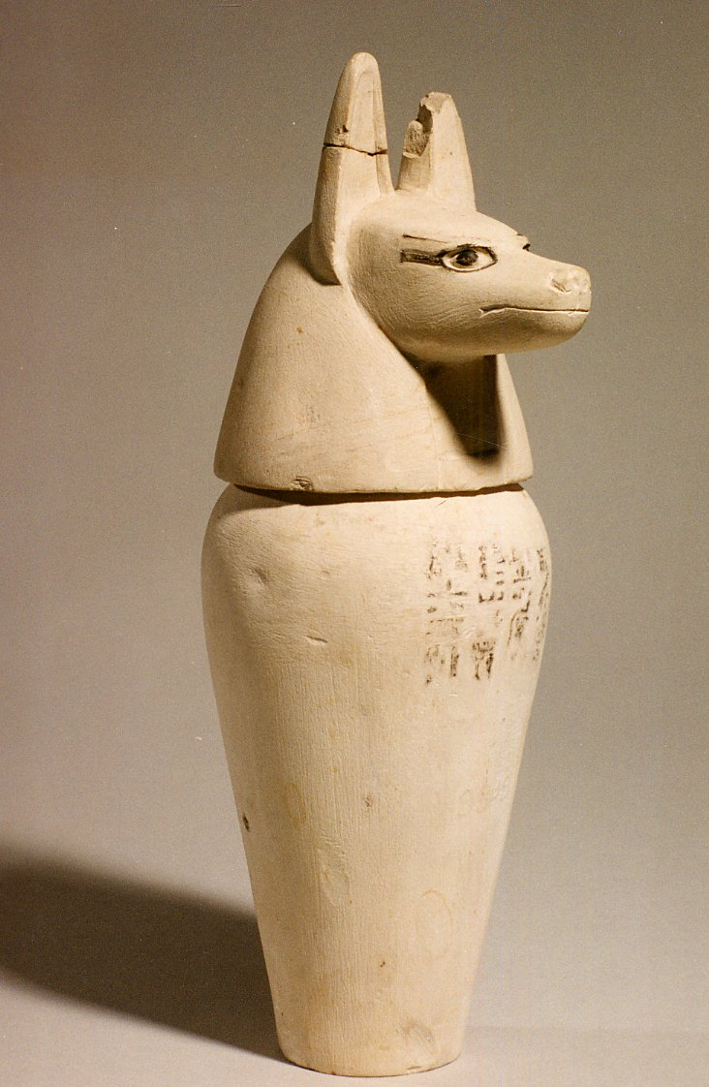
While the body was drying, the internal organs were also dried and preserved with natron.
They were then wrapped in strips of linen and put into separate containers called canopic jars.
The Egyptians believed that all body parts would be magically reunited in the afterlife and the body would become whole again, just like the god Osiris.

Slide 10
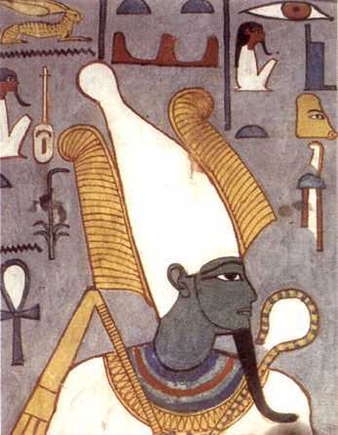
According to Egyptian mythology, the god Osiris was murdered by his jealous brother Set and hacked into pieces. The goddess Isis reassembled the pieces and Osiris was magically restored and went on to become the god of the afterlife.

Slide 11
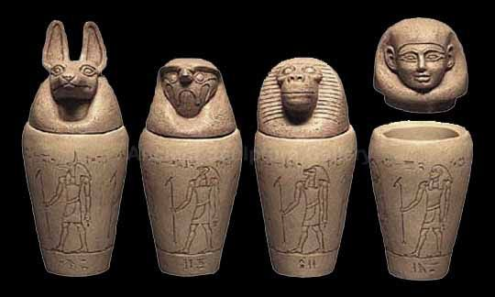
The stoppers of the canopic jars were shaped like the heads of the four sons of the god Horus. Each son protected the organ placed inside his respective jar. Duamutef, who had the head of a jackal, guarded the jar that contained the stomach. Qebehsenuf, who had the head of a falcon, watched over the intestines. Hapi, the baboon-headed son of Horus, protected the lungs, while human-headed Imseti was in charge of protecting the liver.

Slide 12
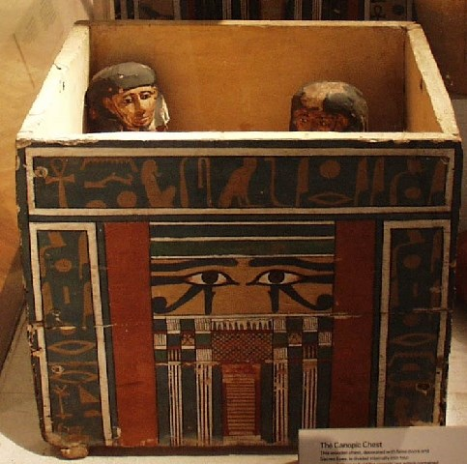
Canopic jars were usually stored in a chest that was later placed in the tomb with the mummy.

Slide 13
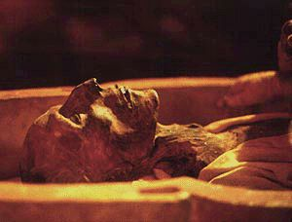
After 40 days, the body was completely dried. The skin became shrunken, wrinkled, and leathery. The bundles of natron were removed from the body cavity. The mummy was cleaned one more time and rubbed with sacred oils to soften the skin.

Slide 14
The mummy’s head and body were packed with herbs, sawdust, and linen soaked in scented oil so that they could regain the shape they had in life. Stones or small onions were placed under the eyelids to restore a lifelike appearance. Once this was done, the mummy could be covered with necklaces, rings, and bracelets made of gold and gems.

Slide 15
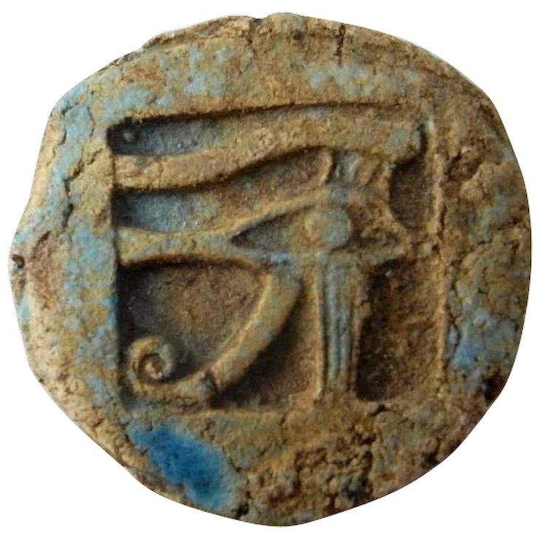
In one Egyptian myth, the god Horus had his eye miraculously restored after losing it in a battle with the evil god Set. The Eye of Horus, called a wedjat, is associated with healing and protection. A wax or bronze plate with a wedjat carved on it was placed over the embalming incision to magically heal the gash in the afterlife.

Slide 16
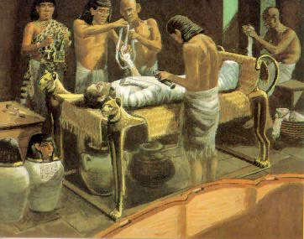
The entire body was then covered in shrouds and bound with strips of linen until the mummy had returned to its original size. This was a complicated job and could take as long as a week.

Slide 17
Small magical amulets were inserted between the layers of the bandages to further protect the mummy’s spirit on its way to the afterlife. As each layer was added, it was coated with resin to hold the wrappings together with a waterproof seal.

Slide 18
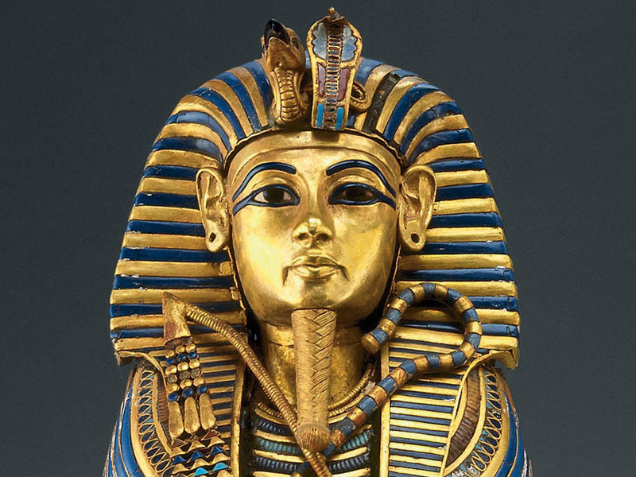
After the wrapping was finished, the head of the mummy was covered with a portrait mask, just to make sure that the spirit would recognize it.

Slide 19
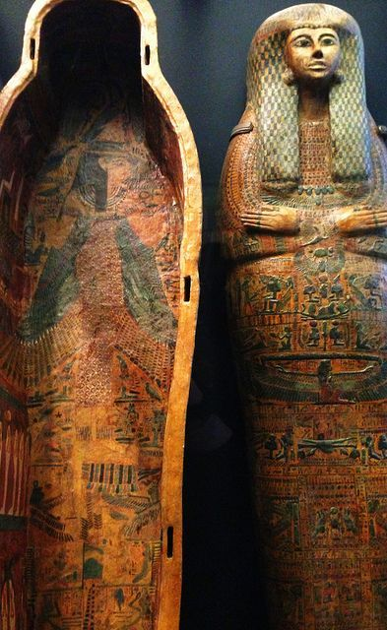
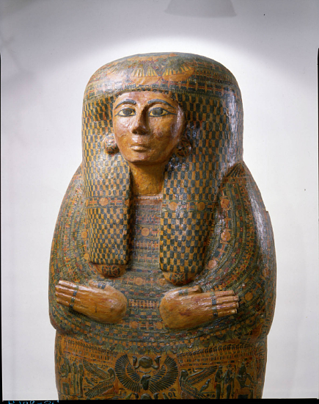
The masked mummy was then placed in a series of gilded wooden coffins and put into a sarcophagus.

Slide 20
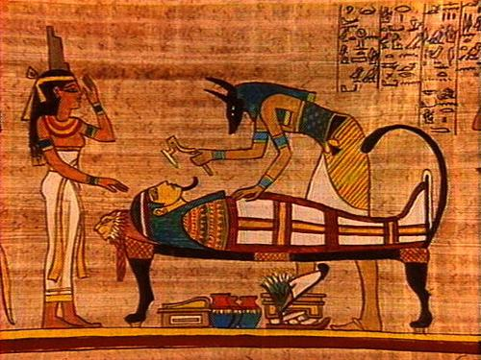
On the day of the funeral, the mummy was brought to the tomb, where priests performed the Opening of the Mouth Ritual – touching the eyes, nose, and mouth of the coffin with a sacred tool. This ritual reactivated these senses for the afterlife.

Slide 21
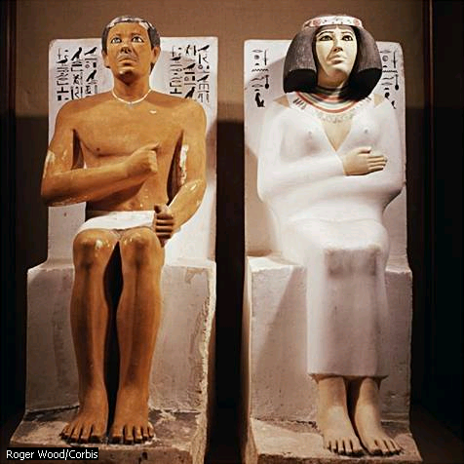
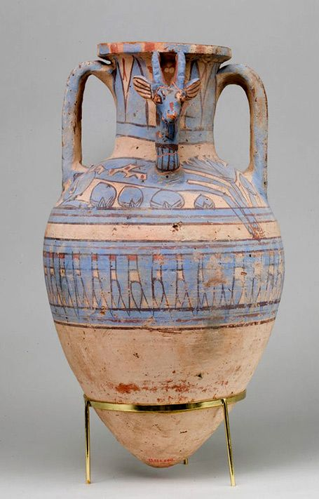
Before the tomb was sealed, family members left food, clothes, furniture, and dishes, which the Egyptians believed the deceased would need for eternity.

Slide 22
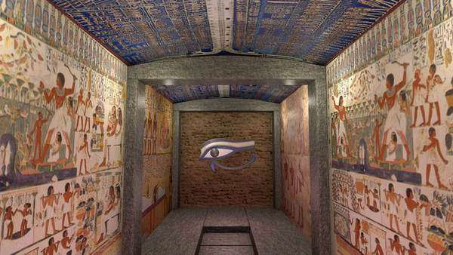
Scenes of offering bearers and daily life were painted on the walls of the tomb, which provided comforting and familiar surroundings for the deceased in the afterlife.

Slide 23
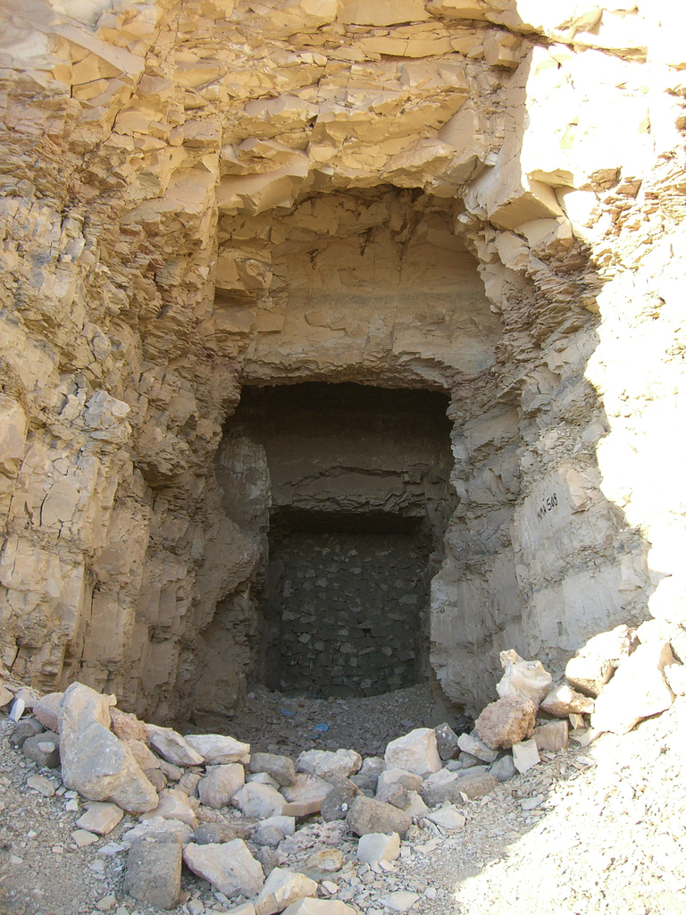
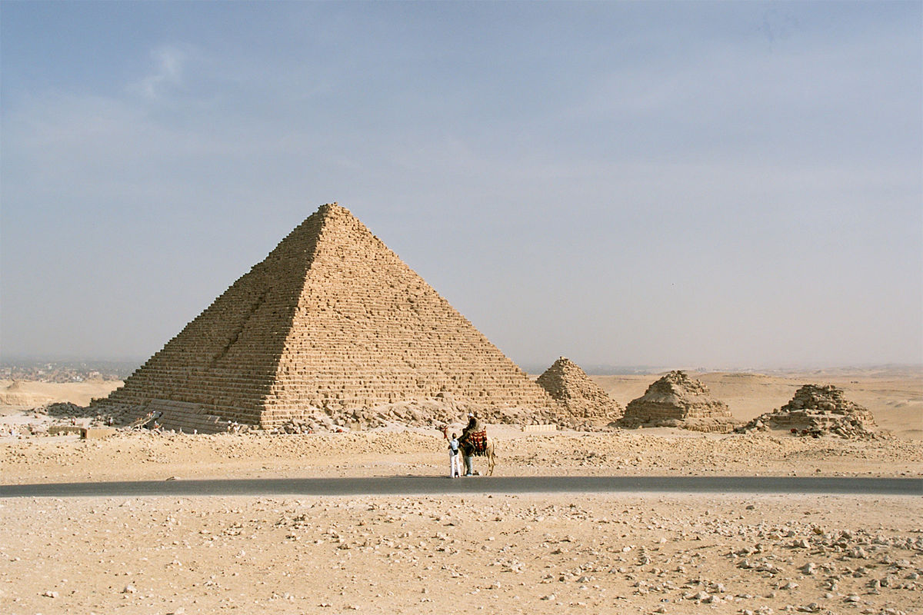
After the tombs were closed, some wealthy families hired priests to periodically offer food to the soul of the deceased. Family members visited the site during special holidays to conduct ceremonies for the deceased.

