Slide 1
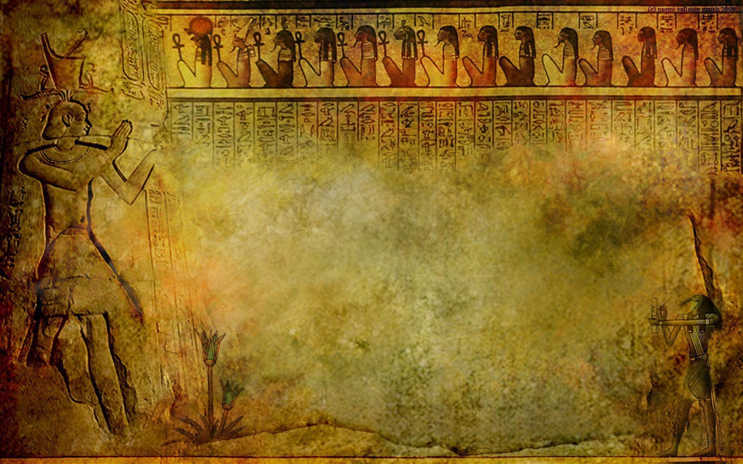
Ancient Egyptian
Architecture

Slide 2
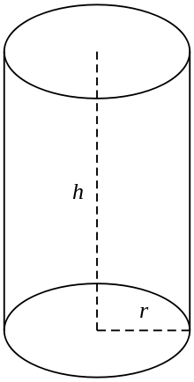
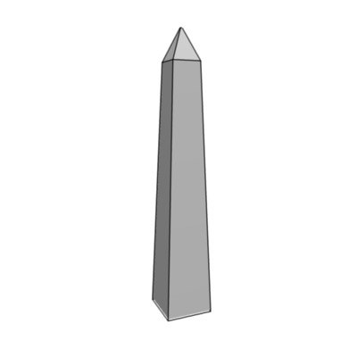
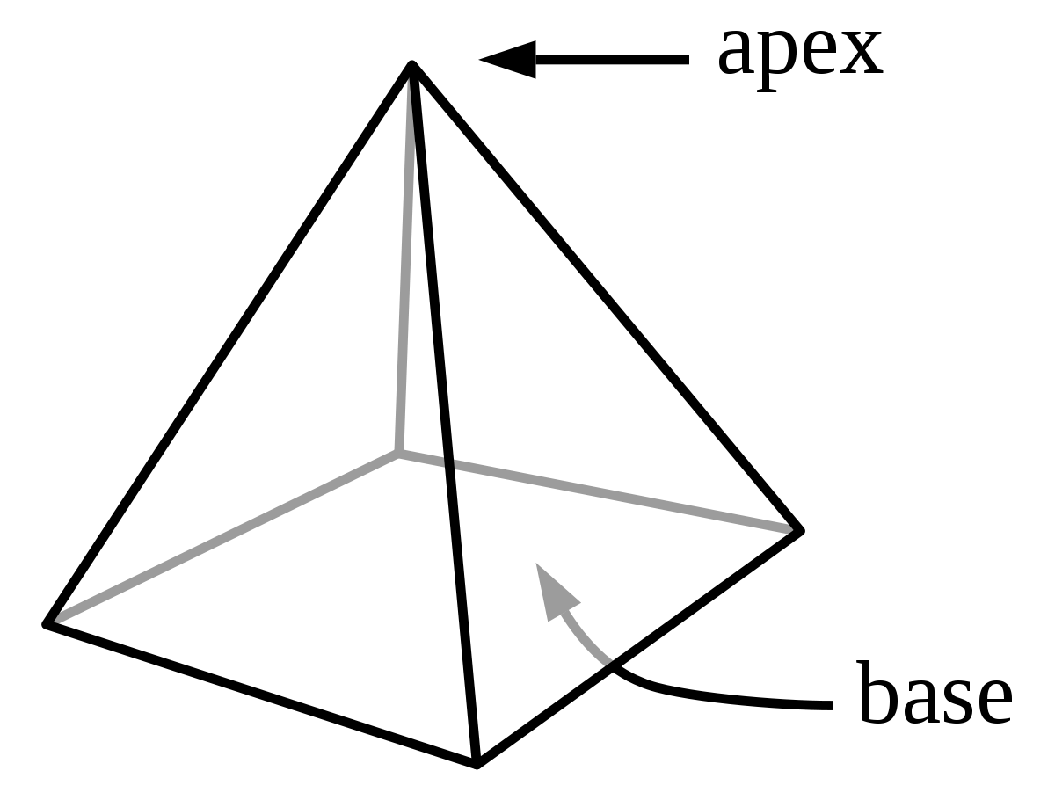
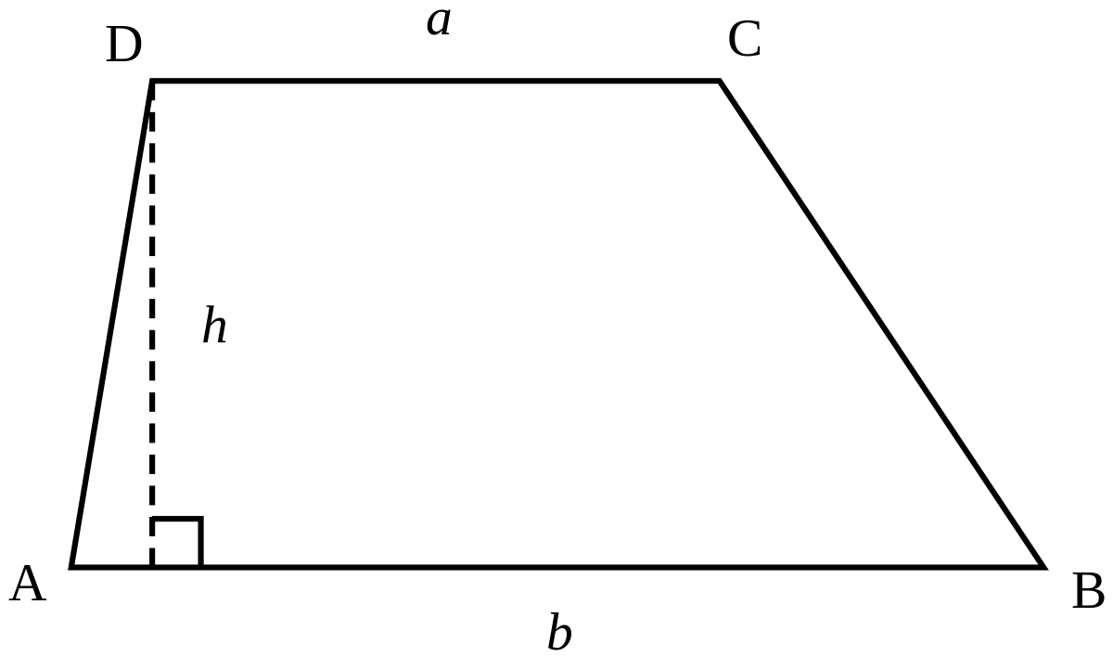
Geometric Shapes
Cylinder
Obelisk
Pyramid
Rectangle
Square
Trapezoid

Slide 3
Assignment
1. You will work in groups of 3 – 4 students (your choice).
2. Each group will select an architectural site or artifact according to the list on
the next slide.
3. Using the hyperlinks on slide #5 and your textbook, you will research your
chosen site/artifact.
4. You will be given a worksheet to guide your research/note-taking process.
5. Materials to be used in constructing your replica site/artifact is up to you.
You and your group will present your site/artifact to the class.
7. Final submission of model will include a written explanation about your model.
8. All structures will be displayed in the classroom and 6th grade hallway.

Slide 4
Architectural Sites and Artifacts
Architectural Sites:
Pyramids at Giza
Sphinx
Abu Simbel
Temple of Deir El Bahari
The White Chapel
Temple at Karnak
King Tut’s Tomb
Luxor Temple
Step Pyramid of Djoser
Temple of Dendur
Obelisk
Egyptian Home
Artifacts:
Egyptian Baths
Shaduf
Egyptian Boat

Slide 5
Internet Research Sites
10 Ancient Egyptian Monuments
Color Me Egypt
Ancient Egypt Antiquities
Ancient Egypt Online
Monuments in Egypt
Canadian Museum of History

Slide 6
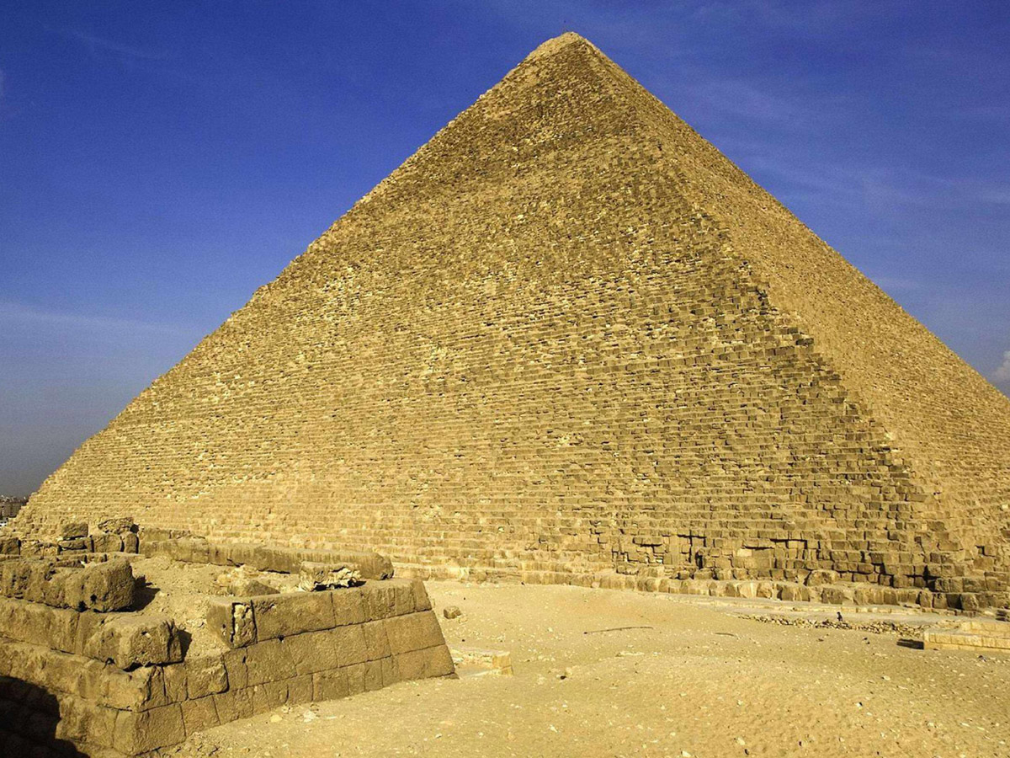
Great Pyramid of Giza
A pyramid is a large structure with four sides that usually slope upward and meet at a point. The base of a pyramid is a square,
and the sides are usually triangles.

Slide 7
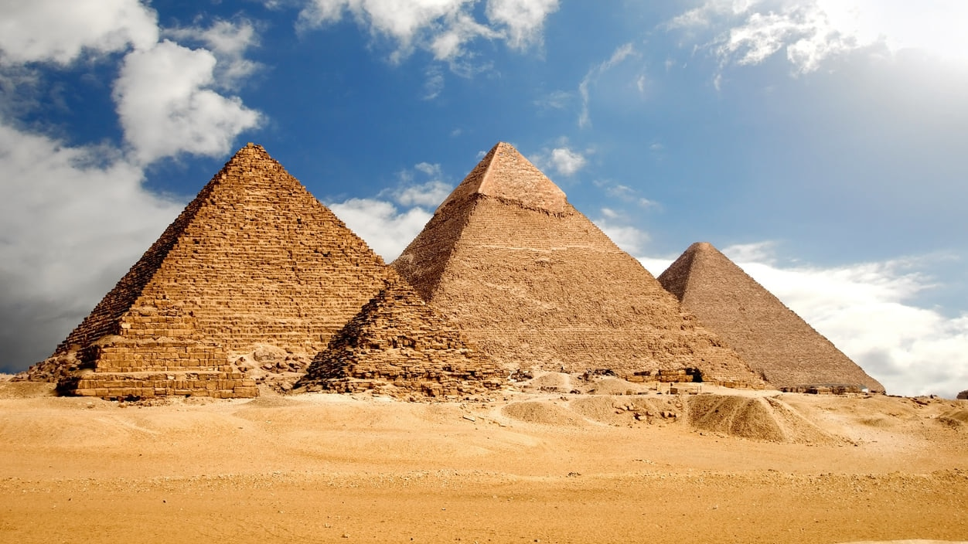
Pyramids of Giza

Slide 8
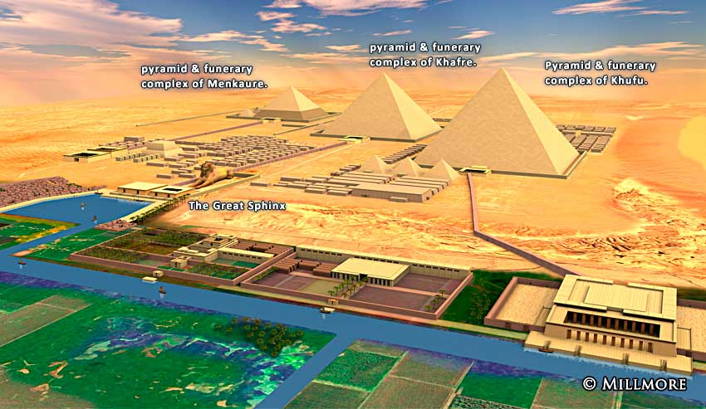
Pyramids of Giza

Slide 9
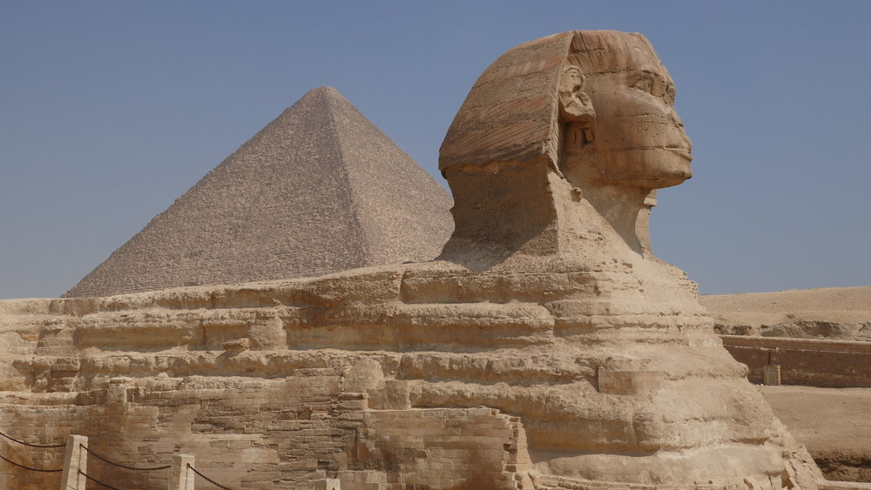
Pyramid of Giza and the Sphinx

Slide 10
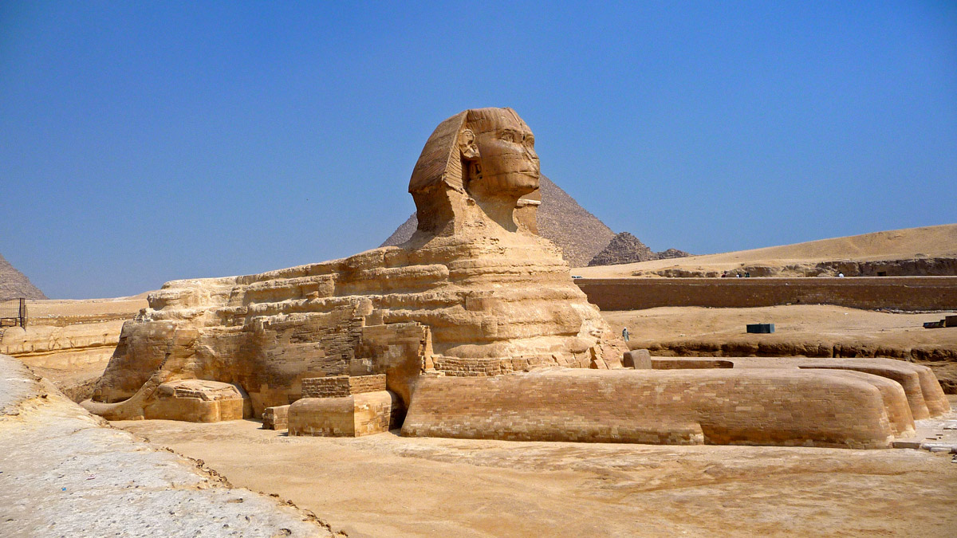
The Sphinx

Slide 11
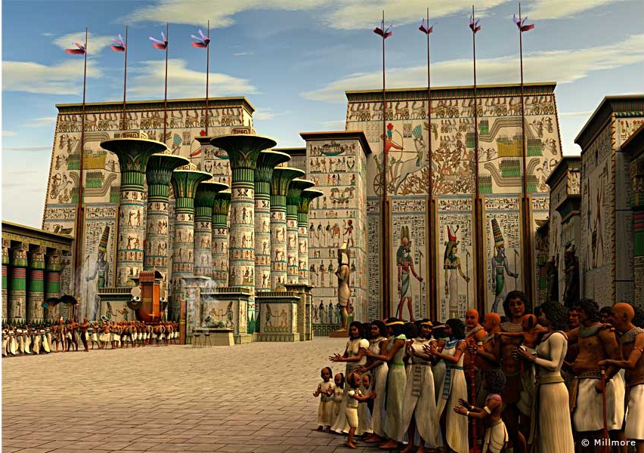
Trapezoids and Cylinders

Slide 12
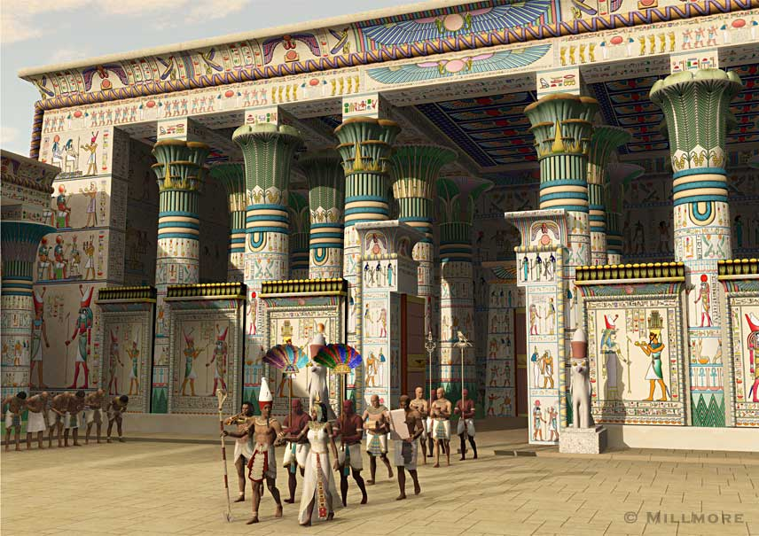
Cylinder
A cylinder is a three-dimensional shape in geometry. A cylinder is round and has a top and bottom in the shape of a circle.
The top and the bottom are flat and always the same size.

Slide 13
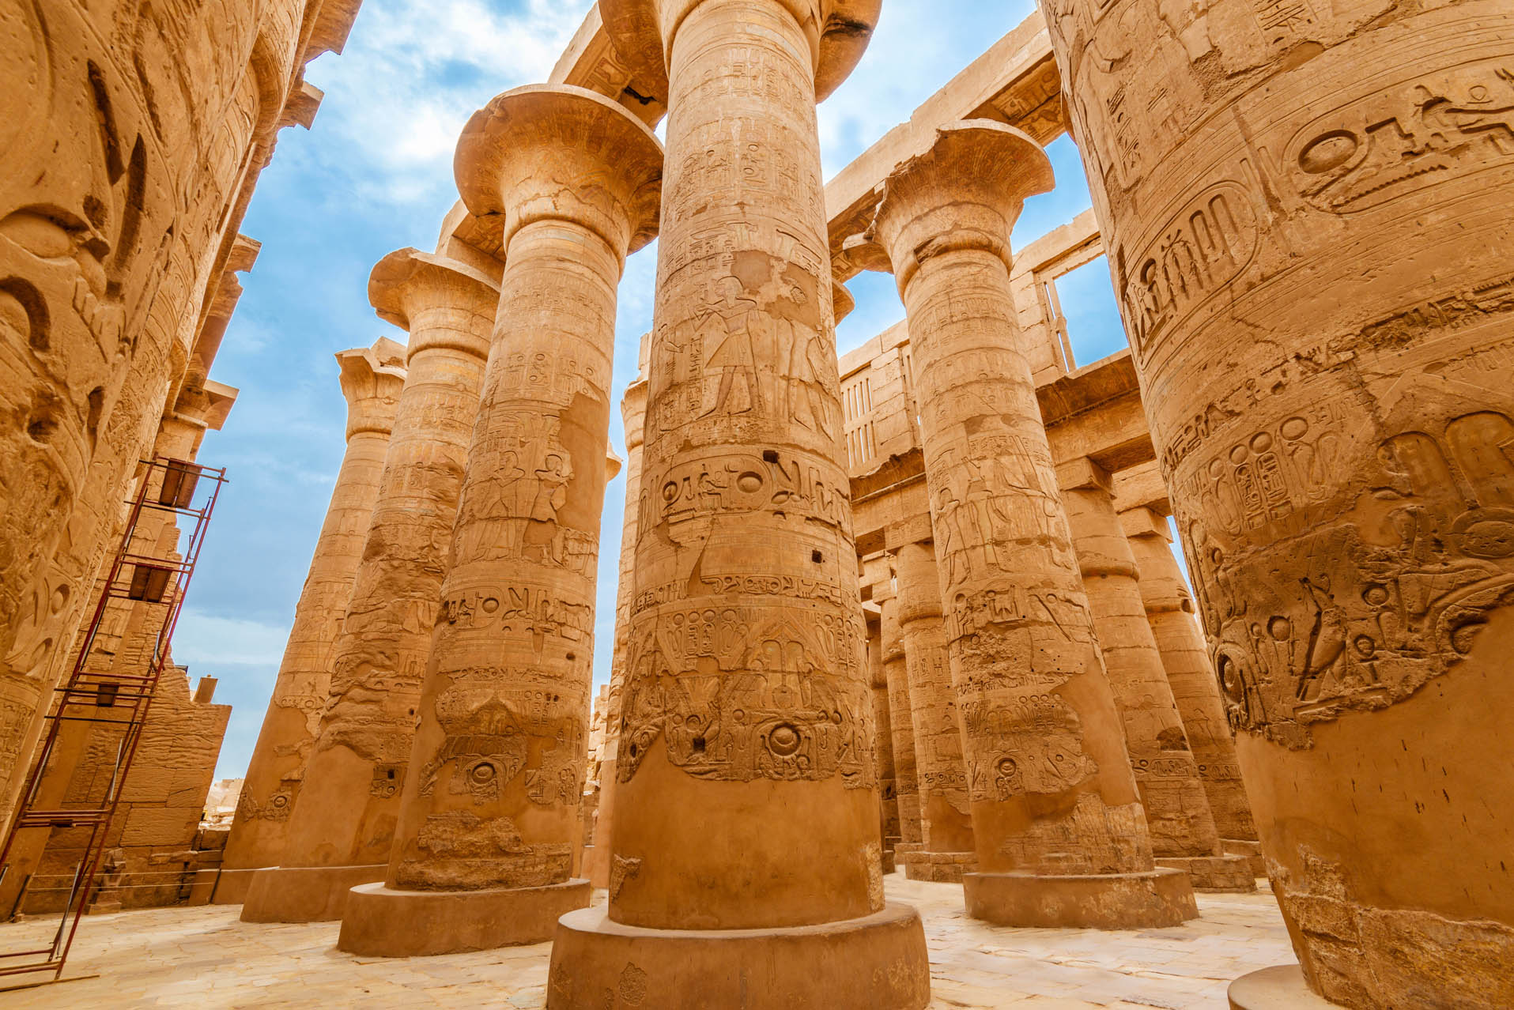
Cylinder

Slide 14
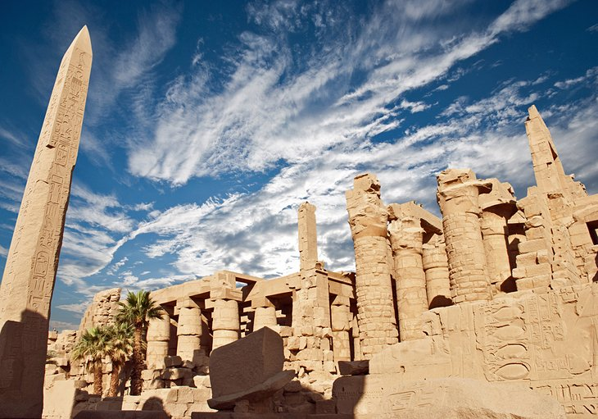
Obelisk
An obelisk is a tall, four-sided, narrow tapering monument which ends in a pyramid-like shape at the top. They are usually found in pairs
at the entrances of ancient Egyptian temples. The Egyptian obelisk was carved from a single piece of stone, usually red granite from the
quarries at Aswān.

Slide 15
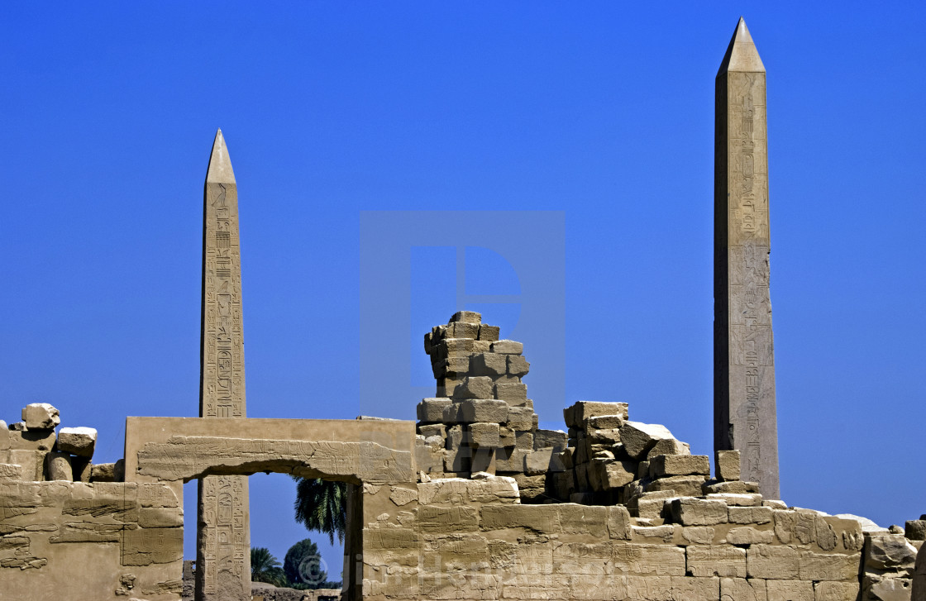
Obelisk

Slide 16
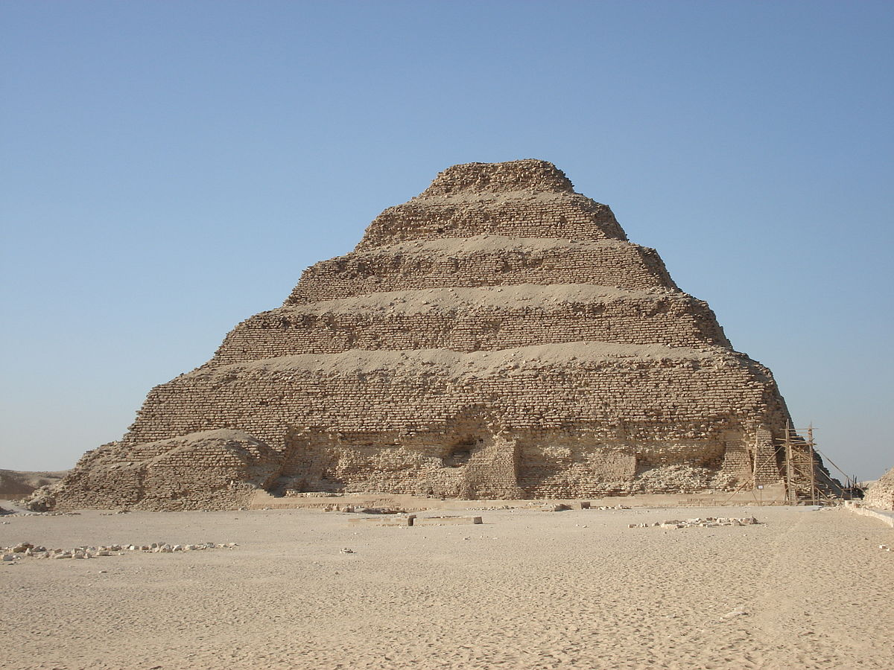
Step Pyramid of Djoser

Slide 17
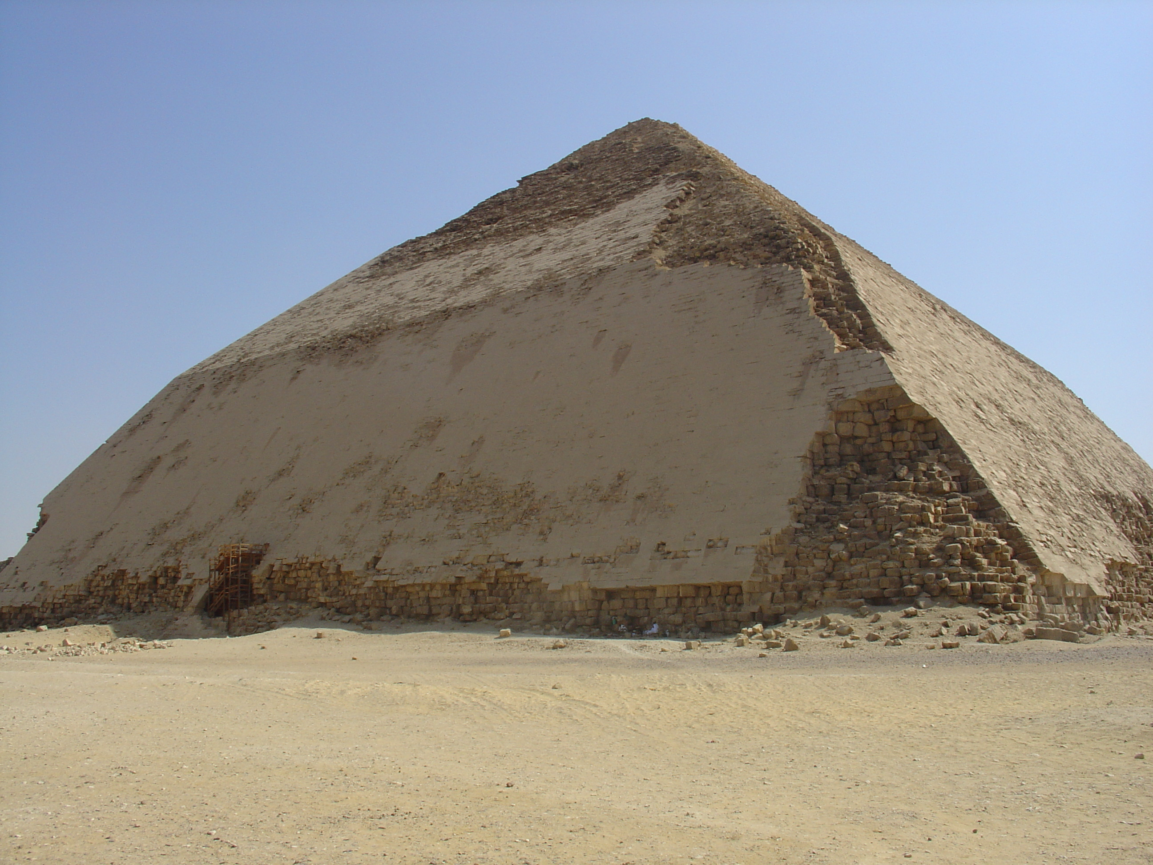
Ancient Bent Pyramid

Slide 18
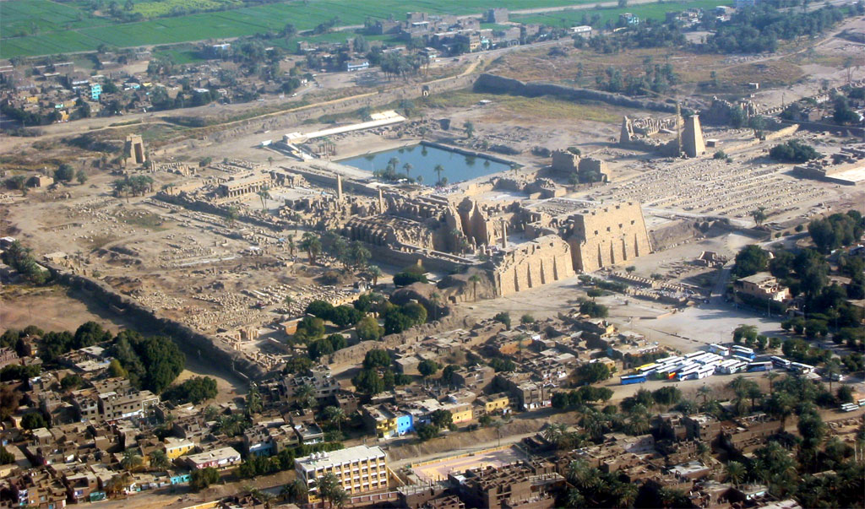
Ancient Karnak Temple Area

Slide 19
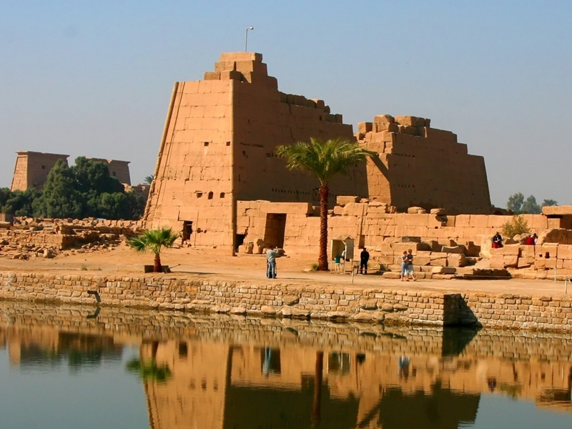
Ancient Karnak Temple
A trapezoid is a 4-sided flat shape with straight sides that has only one pair of parallel sides.

Slide 20
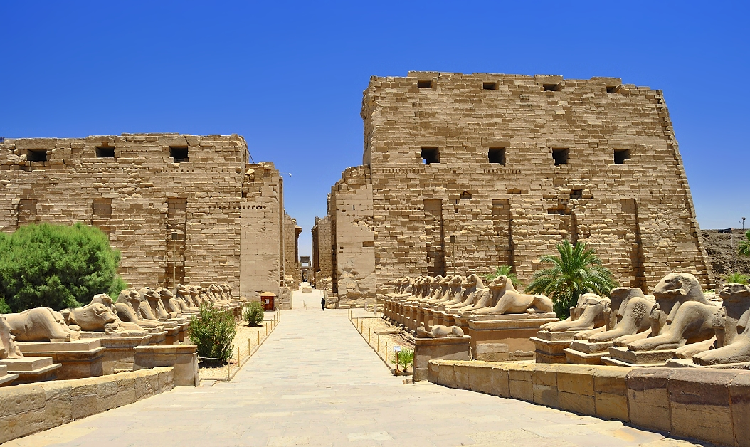
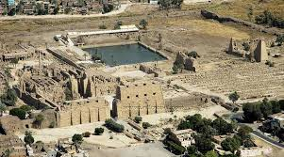
Ancient Karnak Temple

Slide 21
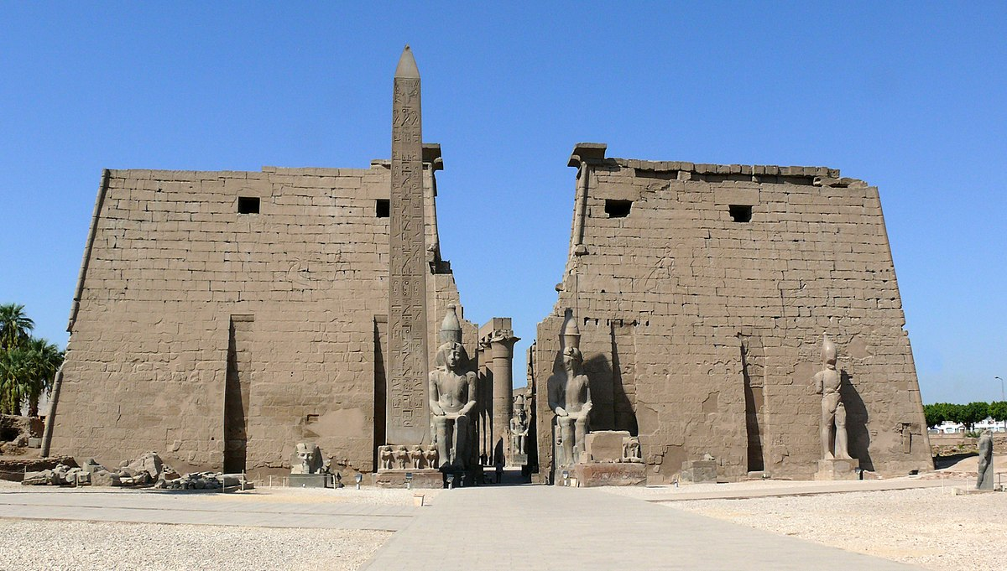
Luxor Temple (Also known as Thebes or the “City of a Hundred Gates,” Luxor was the capital of Egypt in ancient times.)

Slide 22
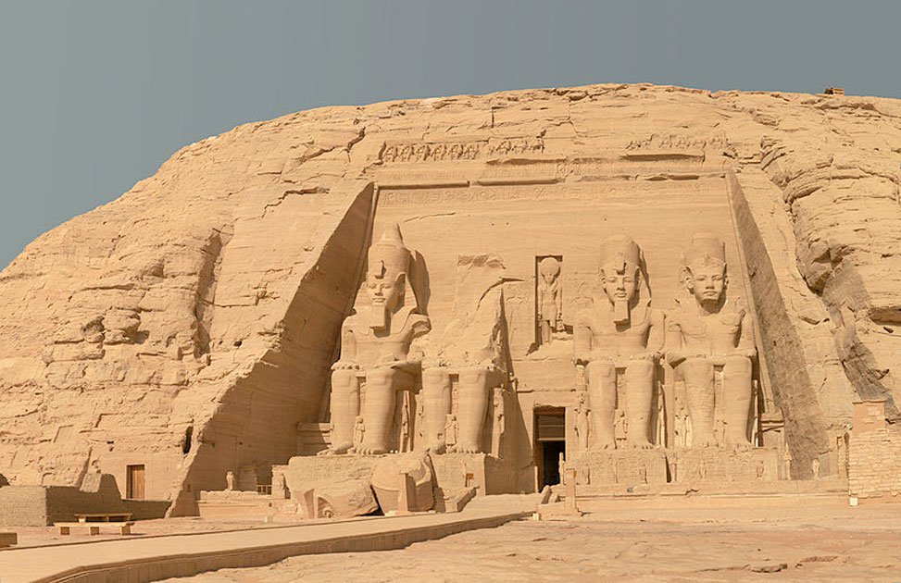
Abu Simbel Temple (Great Temple of Ramses - Abu Simbel is a village in Nubia, Upper Egypt, near the border with Sudan.)

Slide 23
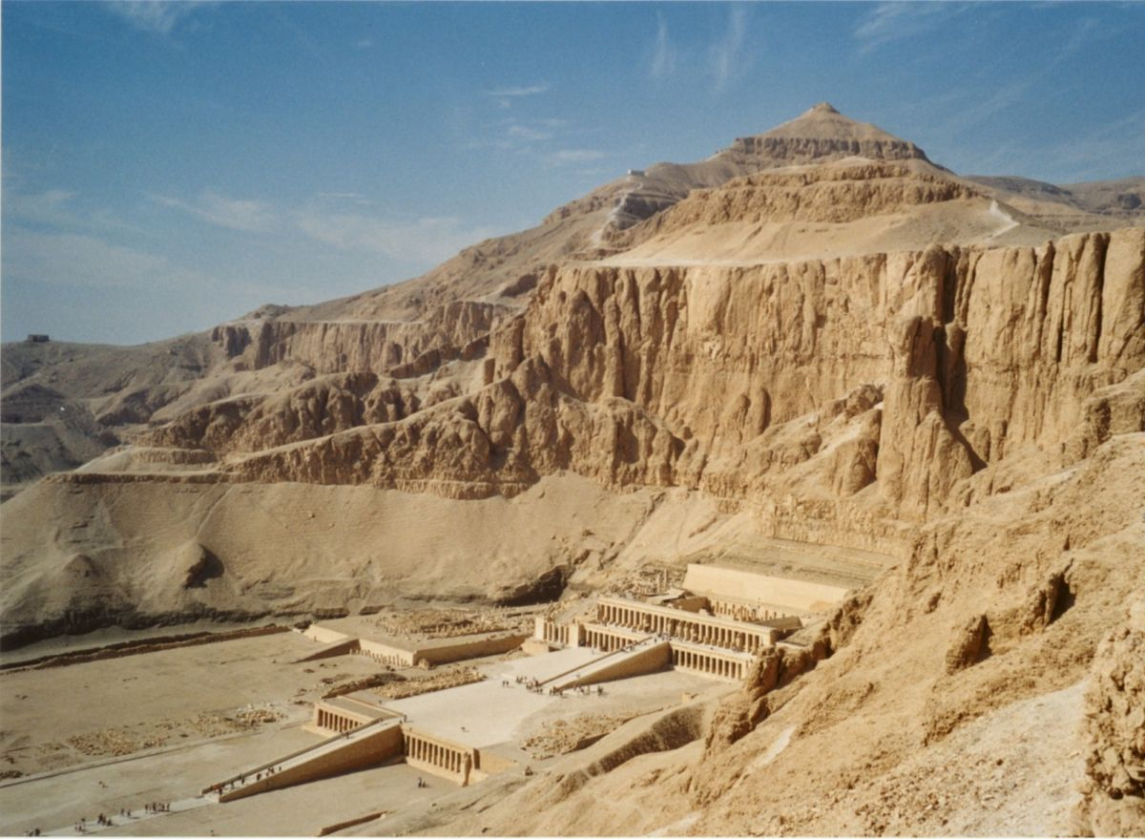
Temple of Deir al-Bahri (Valley of the Kings - Queen Hatshepsut's Temple)

Slide 24
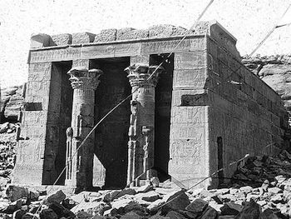
Temple of Dendur

Slide 25
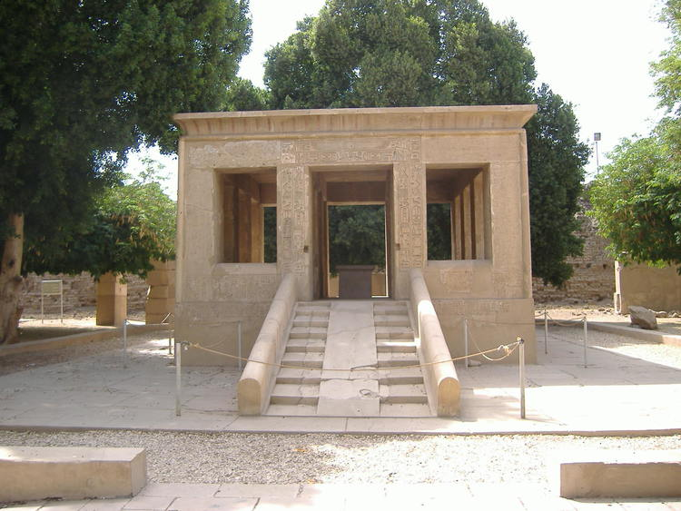
The White Chapel Senruset

Slide 26
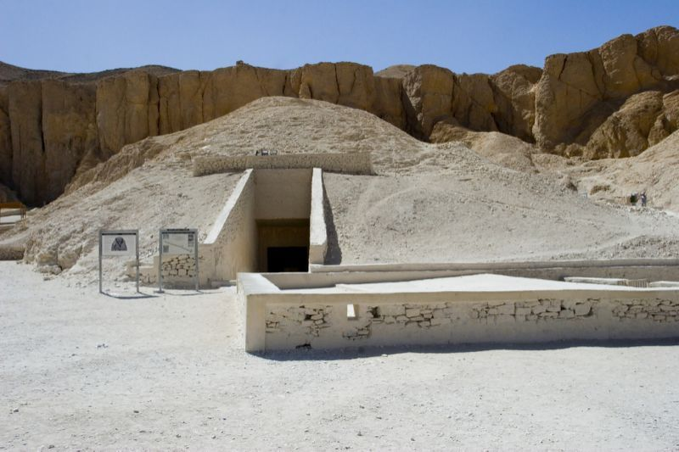
King Tut’s Tomb

Slide 27
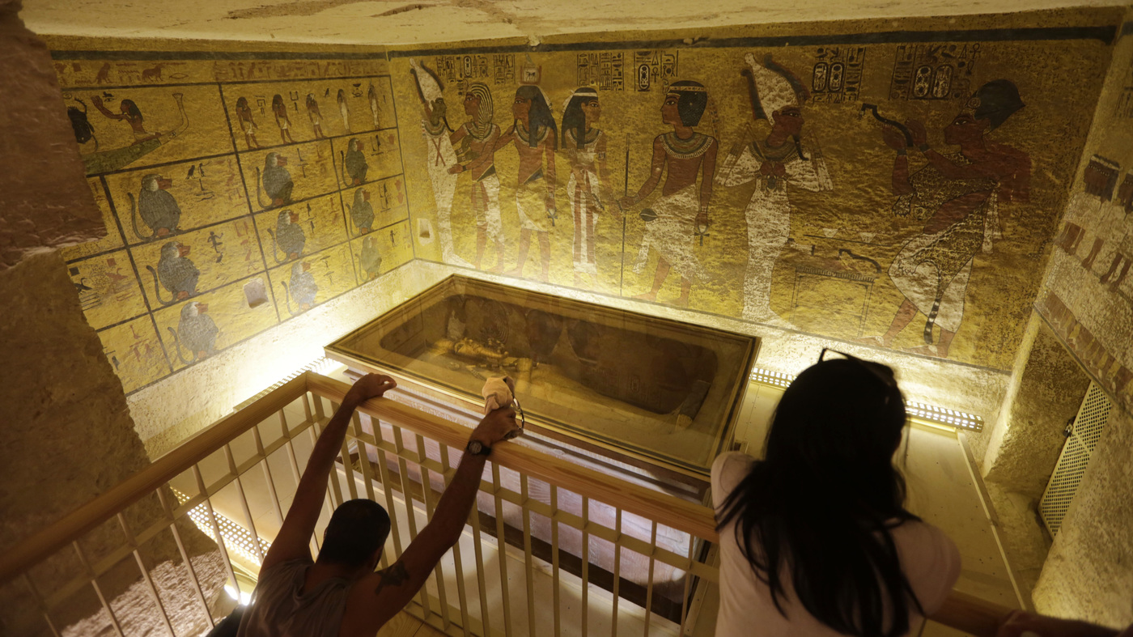
King Tut’s Tomb

Slide 28
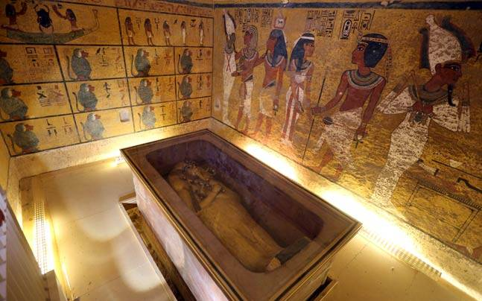
King Tut’s Tomb

Slide 29
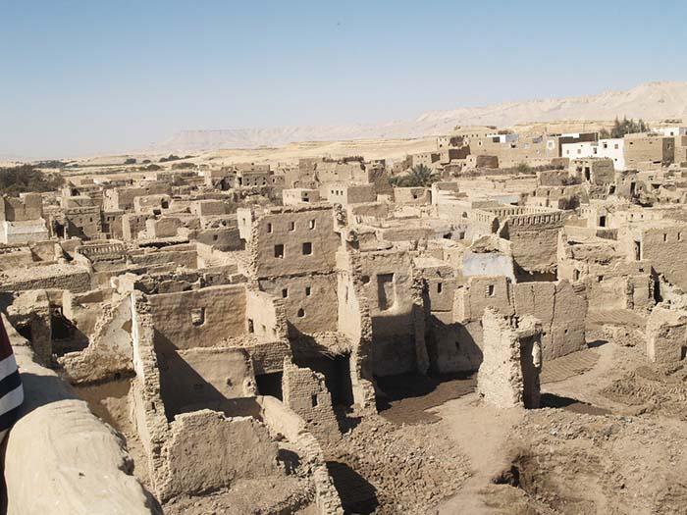
Ancient Egyptian Homes

Slide 30
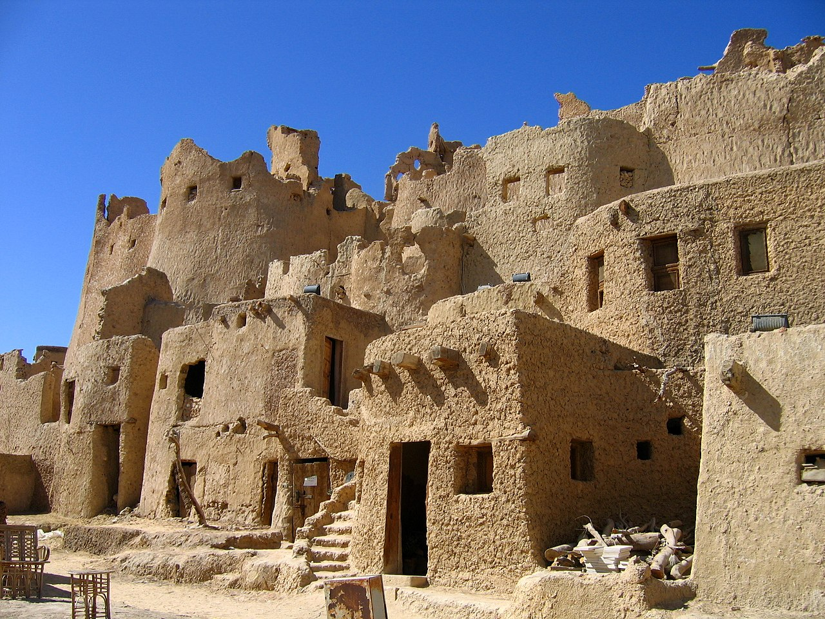
Ancient Egyptian Homes

Slide 31
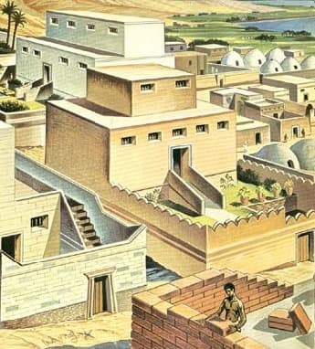
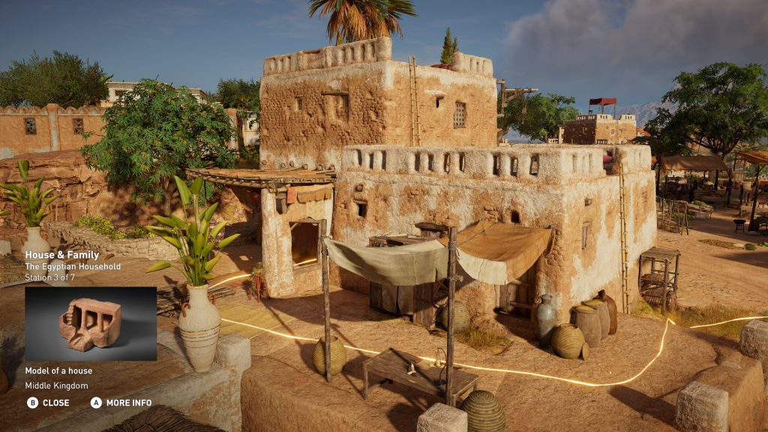
Ancient Egyptian Homes

Slide 32
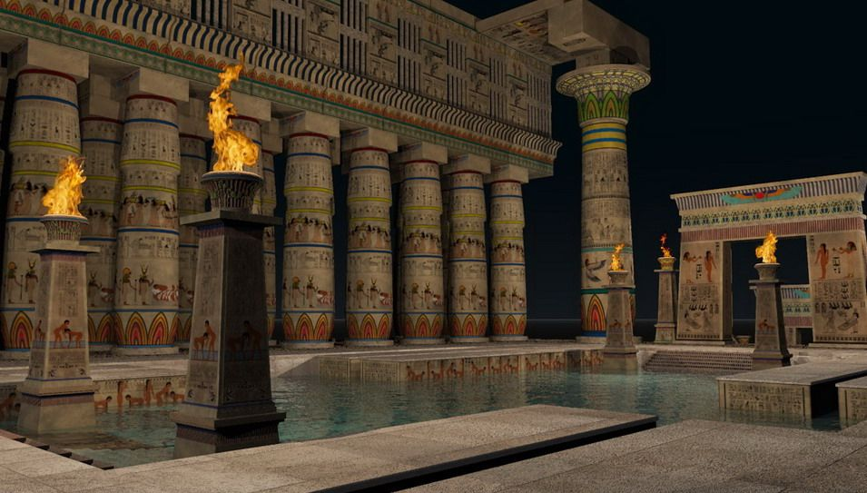
Ancient Egyptian Public Baths

Slide 33
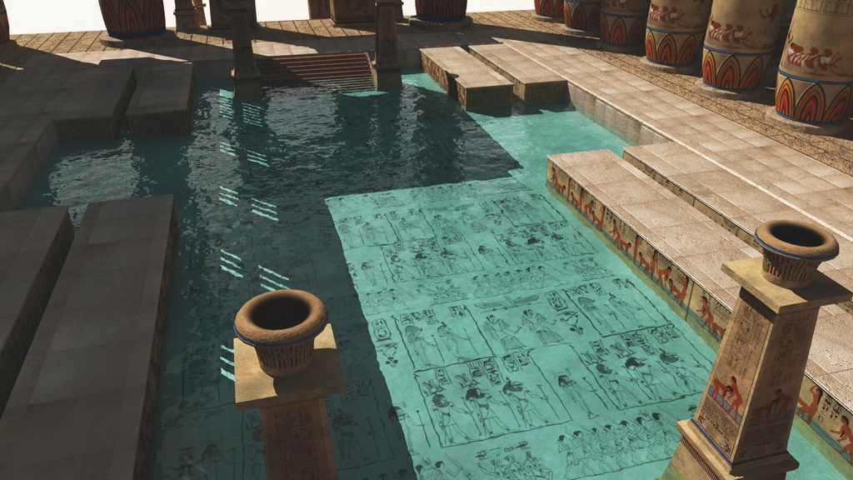
Ancient Egyptian Public Baths

Slide 34
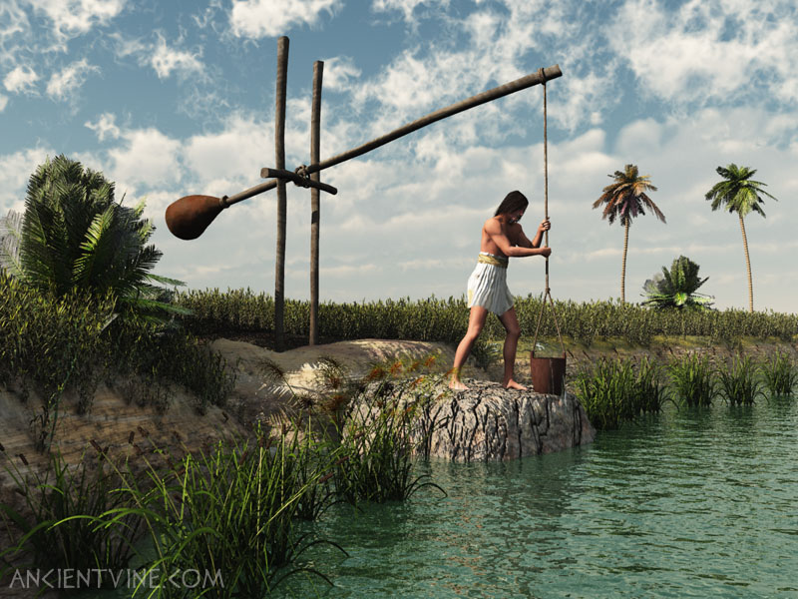
Ancient Egyptian Shaduf

Slide 35
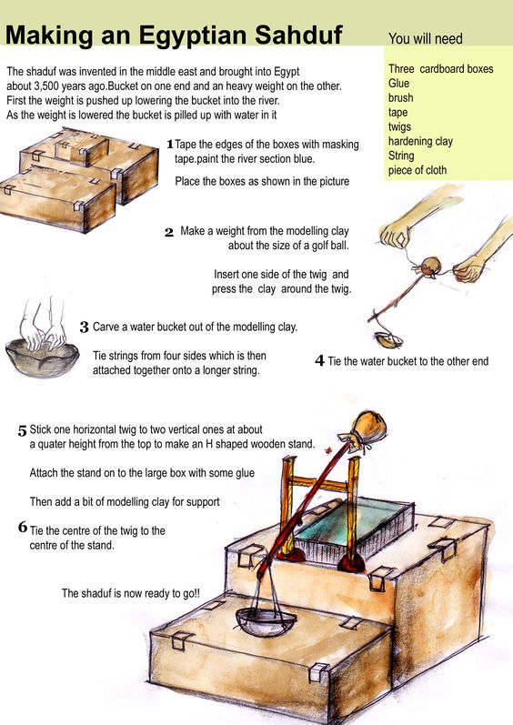
Sahduf

Slide 36
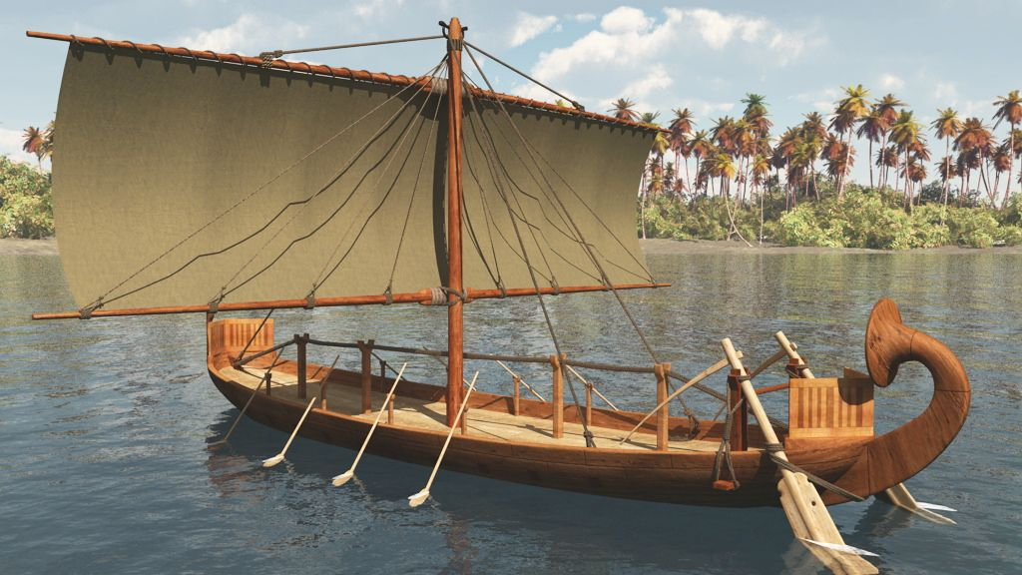
Ancient Egyptian Boat

Slide 37
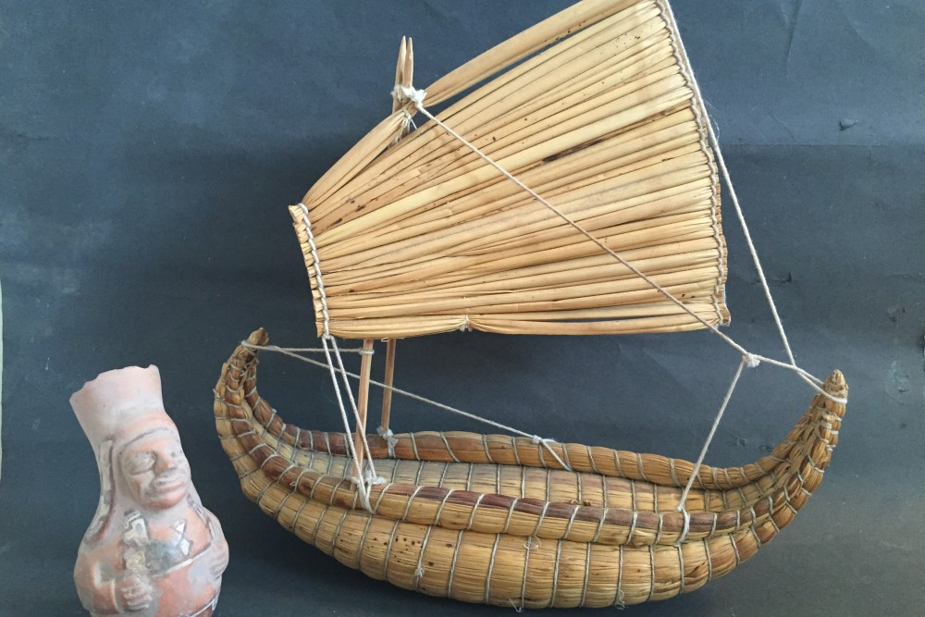
Ancient Egyptian Boat

